Slide 1
Starting a Spiritual Conversation

Slide 2
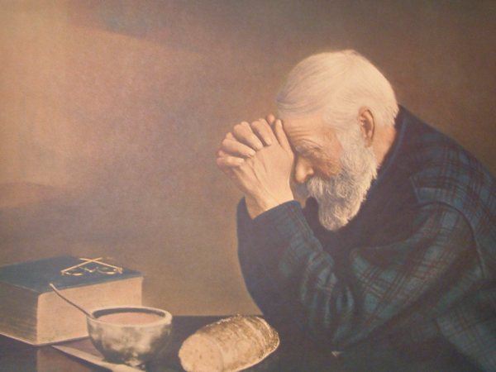

Slide 3
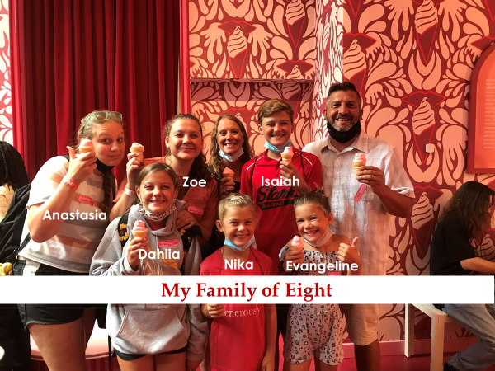

Slide 4
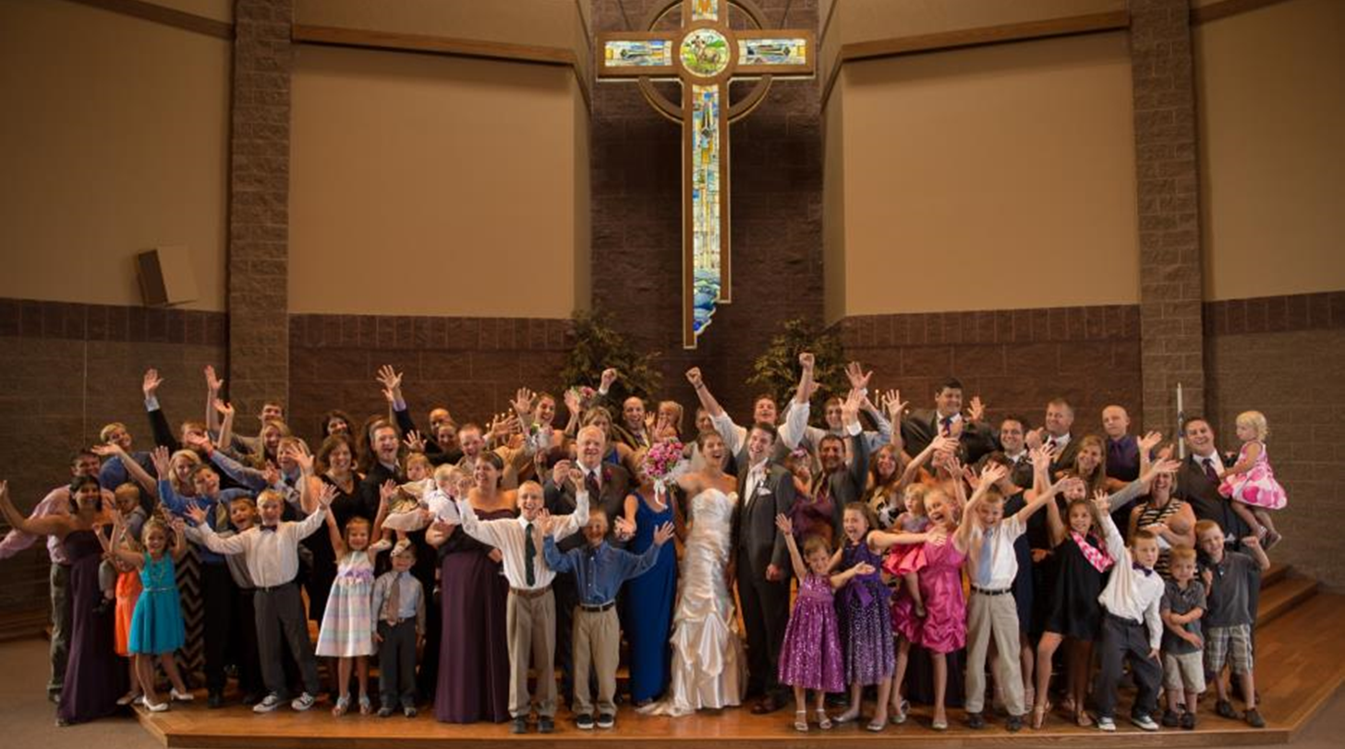
My Family of Many

Slide 5
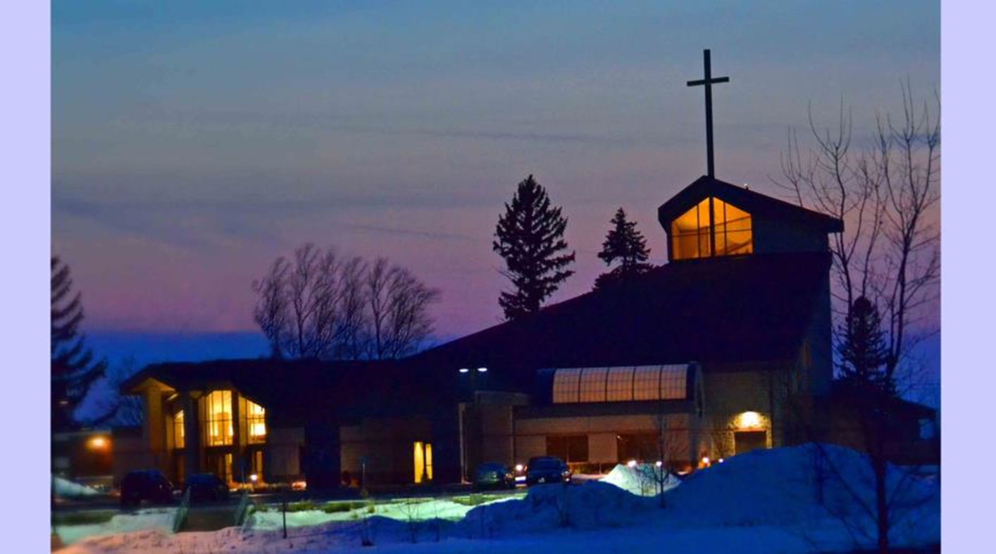
Immanuel in Greenville, WI

Slide 6
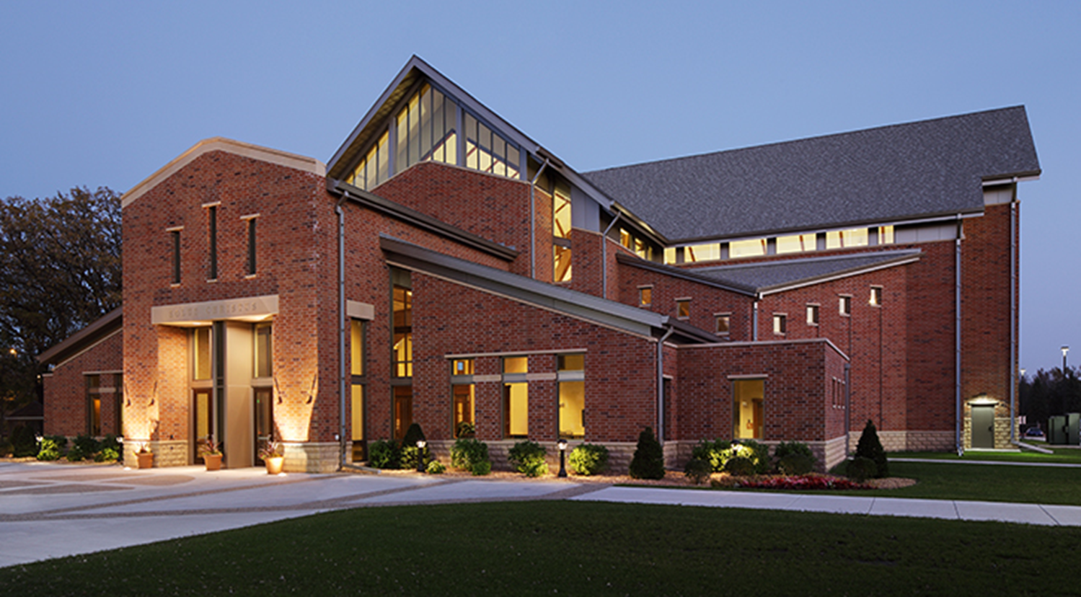

Slide 7
Why Is Talking Religion Hard?

Slide 8
Tamar

Slide 9
Listening Activity
Partner up.
Pick one person to tell his/her life story in one minute. The other person listens.

Slide 10
Listening Activity
Was your partner listening, and how can you tell?

Slide 11
1.
Listen Actively
Earn the right to speak by listening first.

Slide 12
Things to Keep in Mind!
Expectations
 | What do I want?
Be Genuine
 | Don’t pretend
Care for People
 | No Evangelist Belt

Slide 13
Put the following percentages where you think they belong: 3%, 9%, 14%, 18%, 56%
___ Because of previous loyalties to that denomination
___ Because the pastor visited them
___ Because a friend or relative invited them
___ Because trained lay members visited them
___ Because of the church’s location or building

Slide 14
Put the following percentages where you think they belong: 3%, 9%, 14%, 18%, 56%
14% Because of previous loyalties to that denomination
3% Because the pastor visited them
56% Because a friend or relative invited them
9% Because trained lay members visited them
18% Because of the church’s location or building

Slide 15
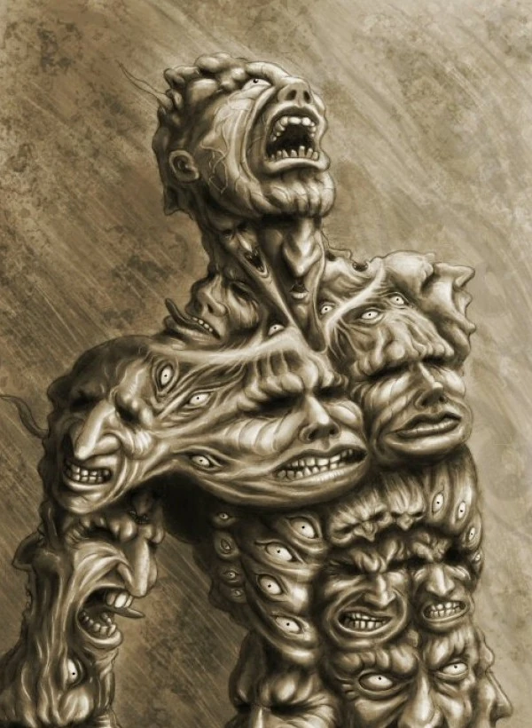
Creepiest Story
in the Bible?

Slide 16
2.
Cross the Bridge

Slide 17
One Possible Turn . . .
Feel
“I can see how you might feel that way . . .”
Felt
“I once felt that way myself . . .”
Found
“But what I’ve found is . . .”

Slide 18
Another Possible Turn . . .
p:
P:
S:
s:

Slide 19
Another Possible Turn . . .
problems
Problem
Solution
solutions

Slide 20
3.
Talk About Jesus

Slide 21
—1 Peter 3:15
“Always be prepared to give an answer to everyone who asks you to give the reason for the hope that you have.”

Slide 22
Make a Witness Outline Your Own!
God’s Great Exchange?
The Apostles’ Creed?
I believe in the God of All-Power.
I believe in the God of Saving Love.
I believe in the God of Eternal Hope.
One Verse?
“The wages of sin is death, but the gift of God is eternal life in Christ Jesus our Lord.” (Romans 6:23)
My Tactic?

Slide 23
4.
Be Confident in God’s Promises

Slide 24
—Luke 10:16
“Whoever listens to you listens to me; whoever rejects you rejects me; but whoever rejects me rejects him who sent me.”

Slide 25
—Matthew 10:19,20
“Do not worry about what to say or how to say it. At that time you will be given what to say, for it will not be you speaking, but the Spirit of your Father speaking through you.”

Slide 26
—Isaiah 55:11
“So is my word that goes out from my mouth: It will not return to me empty, but will accomplish what I desire and achieve the purpose for which I sent it.”

Slide 27
—Matthew 28:20
“Surely I am with you always, to the very end of the age.”

Slide 28
Follow Up!

Slide 30
Image Citations
Slide 2 – Painting of man praying over daily bread, https://www.philipkosloski.com/three-methods-of-prayer-that-will-change-your-life/
Slide 6 – Church exterior photograph, https://www.shayphoto.com/religious/cyg29hxr8w2tjlfar46c1nksopj1wi
Slide 7 – Three people at desk talking, https://sarufm.com/%E0%B6%A2%E0%B7%9C%E0%B6%B6%E0%B7%8A-%E0%B6%91%E0%B6%9A-%E0%B6%91%E0%B6%B4%E0%B7%8F-%E0%B7%80%E0%B7%99%E0%B6%BD%E0%B7%8F-%E0%B6%AF-saru-fm-media/
Slide 15 – Demon’s name, https://robertwimer.com/did-jesus-really-ask-for-a-demons-name/
Slide 19 – Problem/solution, https://owlcation.com/humanities/100-Problem-Solution-Essay-Topics-with-Sample-Essays
Slide 28 – Silhouette of man on clock, https://wau.org/resources/article/building_your_prayer_time_1/

