Slide 1
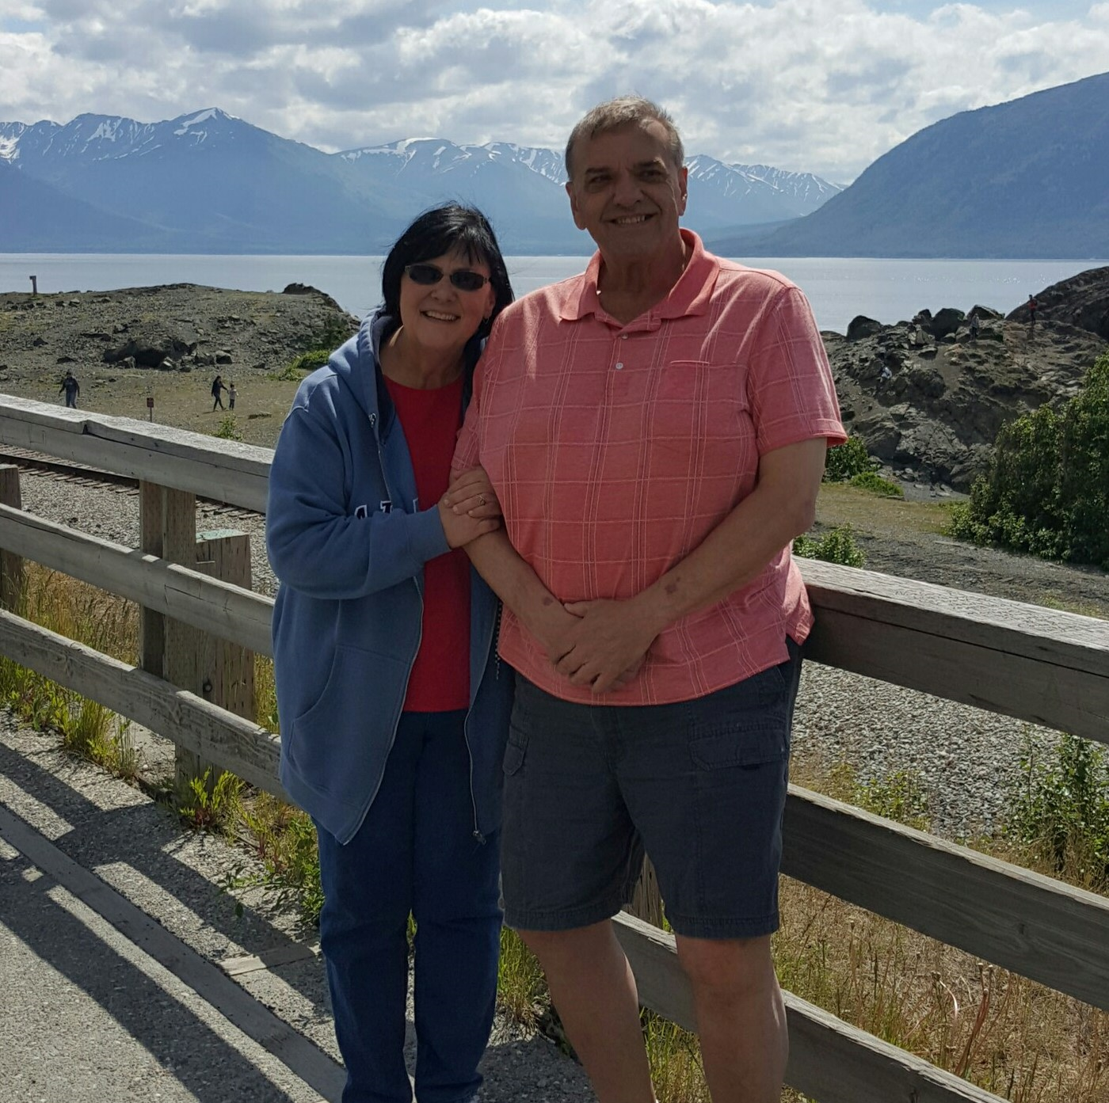
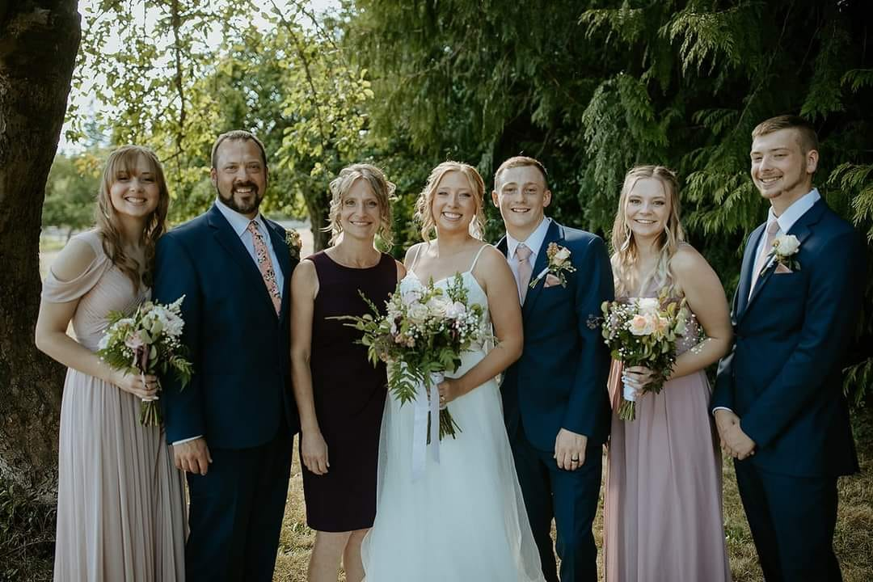
My Mom.
(And yes, it’s likely she’s cooler than yours.)

Slide 2
“Mompliments”
Adj./Noun cf. Adv. Adj.
The art of sharing compliments where at the end they end up really being heinous rips on a person, place, or thing. Most often given by well-meaning, yet subtly accusatory moms.

Slide 3
You’re going outside to hang out with your friends! What a better option than staying in your room “hanging out” with them on your “Discordant.”
Look at your outfit today dear! Aren’t you brave!
What do you have there…a book? I didn’t know you read!

Slide 4
Your room looks so nice! I can actually see the floor now! -How about that?!
You look so much better today! Are you actually wearing makeup?
My aren’t those tattoos just so colorful! Funny, I chose to wear a colored t-shirt today instead.
Oh, that’s a pretty new dress, it’s almost the right size for you!

Slide 5
What’s a person to do?
Eye roll?
We can get angry and come back with one of our own!
We can get so calloused we just say “Well, that’s my mom!”

Slide 6
“Worldpliments”
Adj./Noun cf. Adv. Adj.
The art of sharing compliments where at the end they end up really being heinous rips on someone who loves Jesus and “tries” to follow the Word of God. Most often given by bad-intentioned accusatory people in places of ‘higher learning’, media, social platforms, and politics..

Slide 7
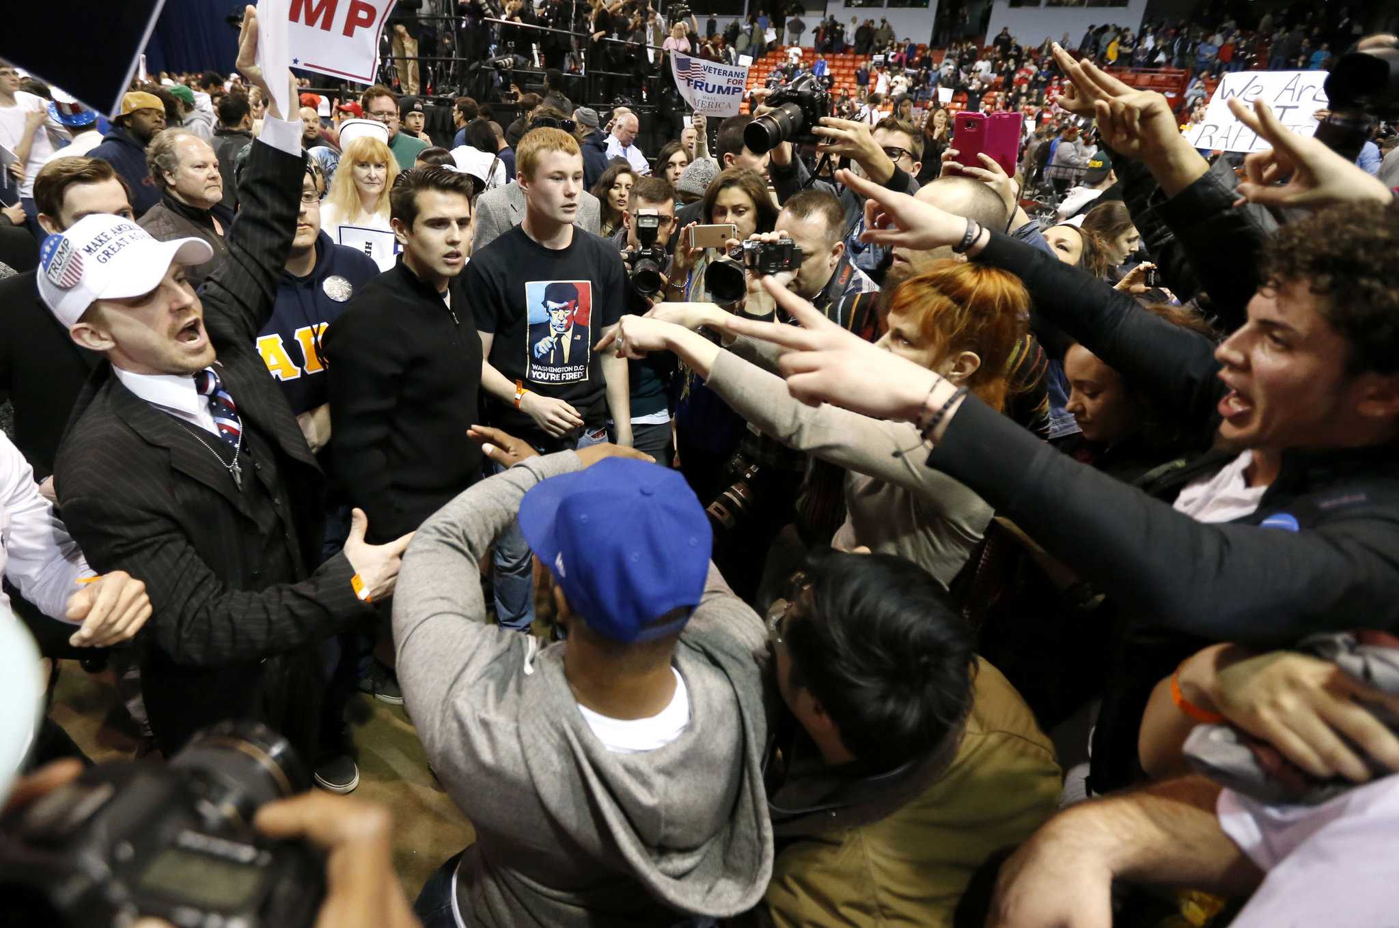
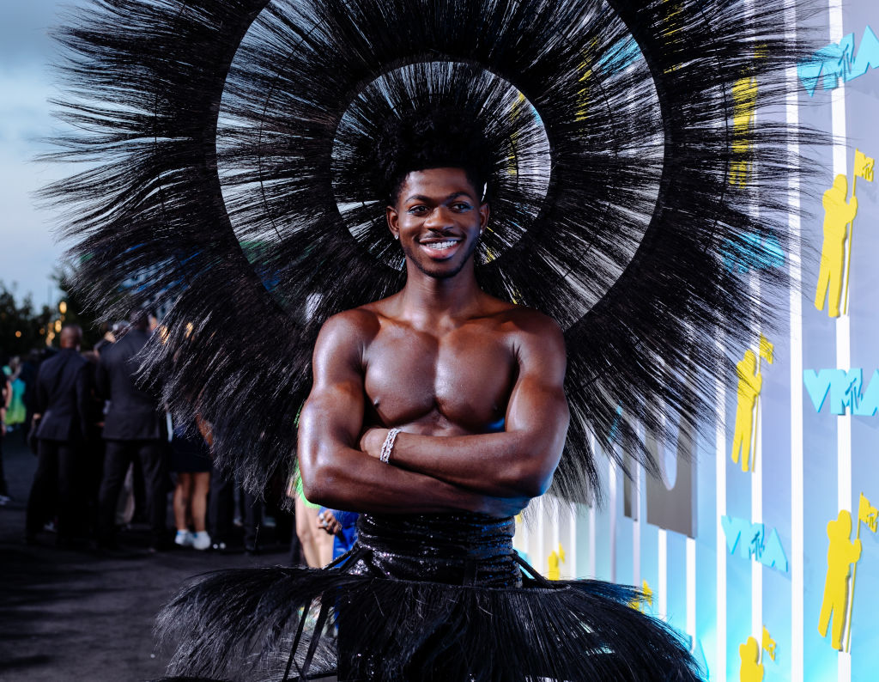
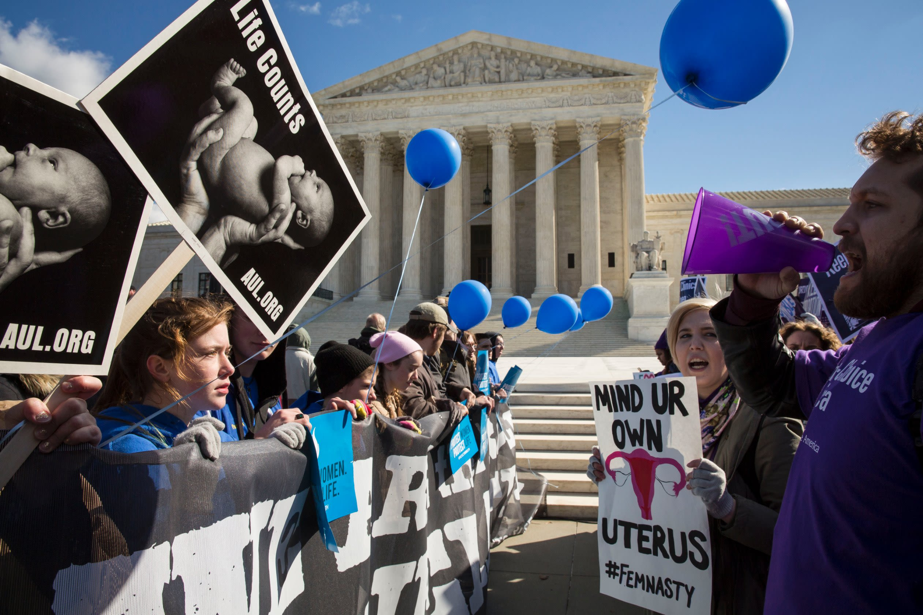
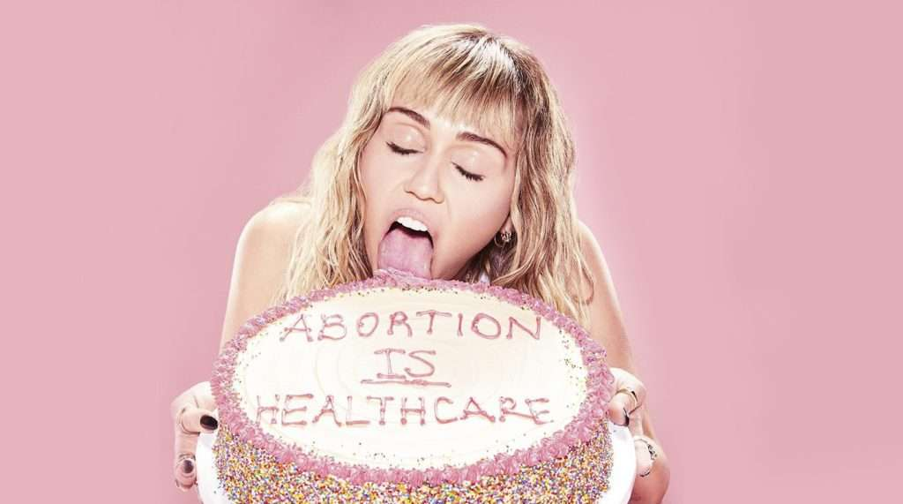
It’s there. And it’s exhausting.

Slide 9
What do we do?
Eye roll?
Get angry?
Calloused and say, “Well, that’s the world I guess…”
OR REMEMBER AND/OR WITNESS JESUS?

Slide 10
“GODPLIMENTS”
Adj./Noun cf. Adv. Adj.
The art of God himself sharing compliments where at the end they end up really being just that- compliments of how much He loves you and how perfect you ARE through Christ! NO STRINGS ATTACHED!

Slide 11
1 Peter 2:3, 9-10
…You have tasted that the Lord is good.
⁹ But you are a chosen people, a royal priesthood, a holy nation, God’s special possession, that you may declare the praises of him who called you out of darkness into his wonderful light. ¹⁰ … you have received mercy.

Slide 12
Chosen People
Royal Priesthood
Holy Nation
God’s Special Possession

Slide 13
Hebrews 10:10,14
¹⁰ We have been made holy through the sacrifice of the body of Jesus Christ once for all. ¹⁴ For by one sacrifice he has made perfect forever those who are being made holy.

Slide 15
PERFECT!

Slide 16
God’s Word Changes…
YOU
God’s World Changers…

Slide 17
From “Mompliments”
To
“Godpliments”
Closing Prayer…

