Slide 2
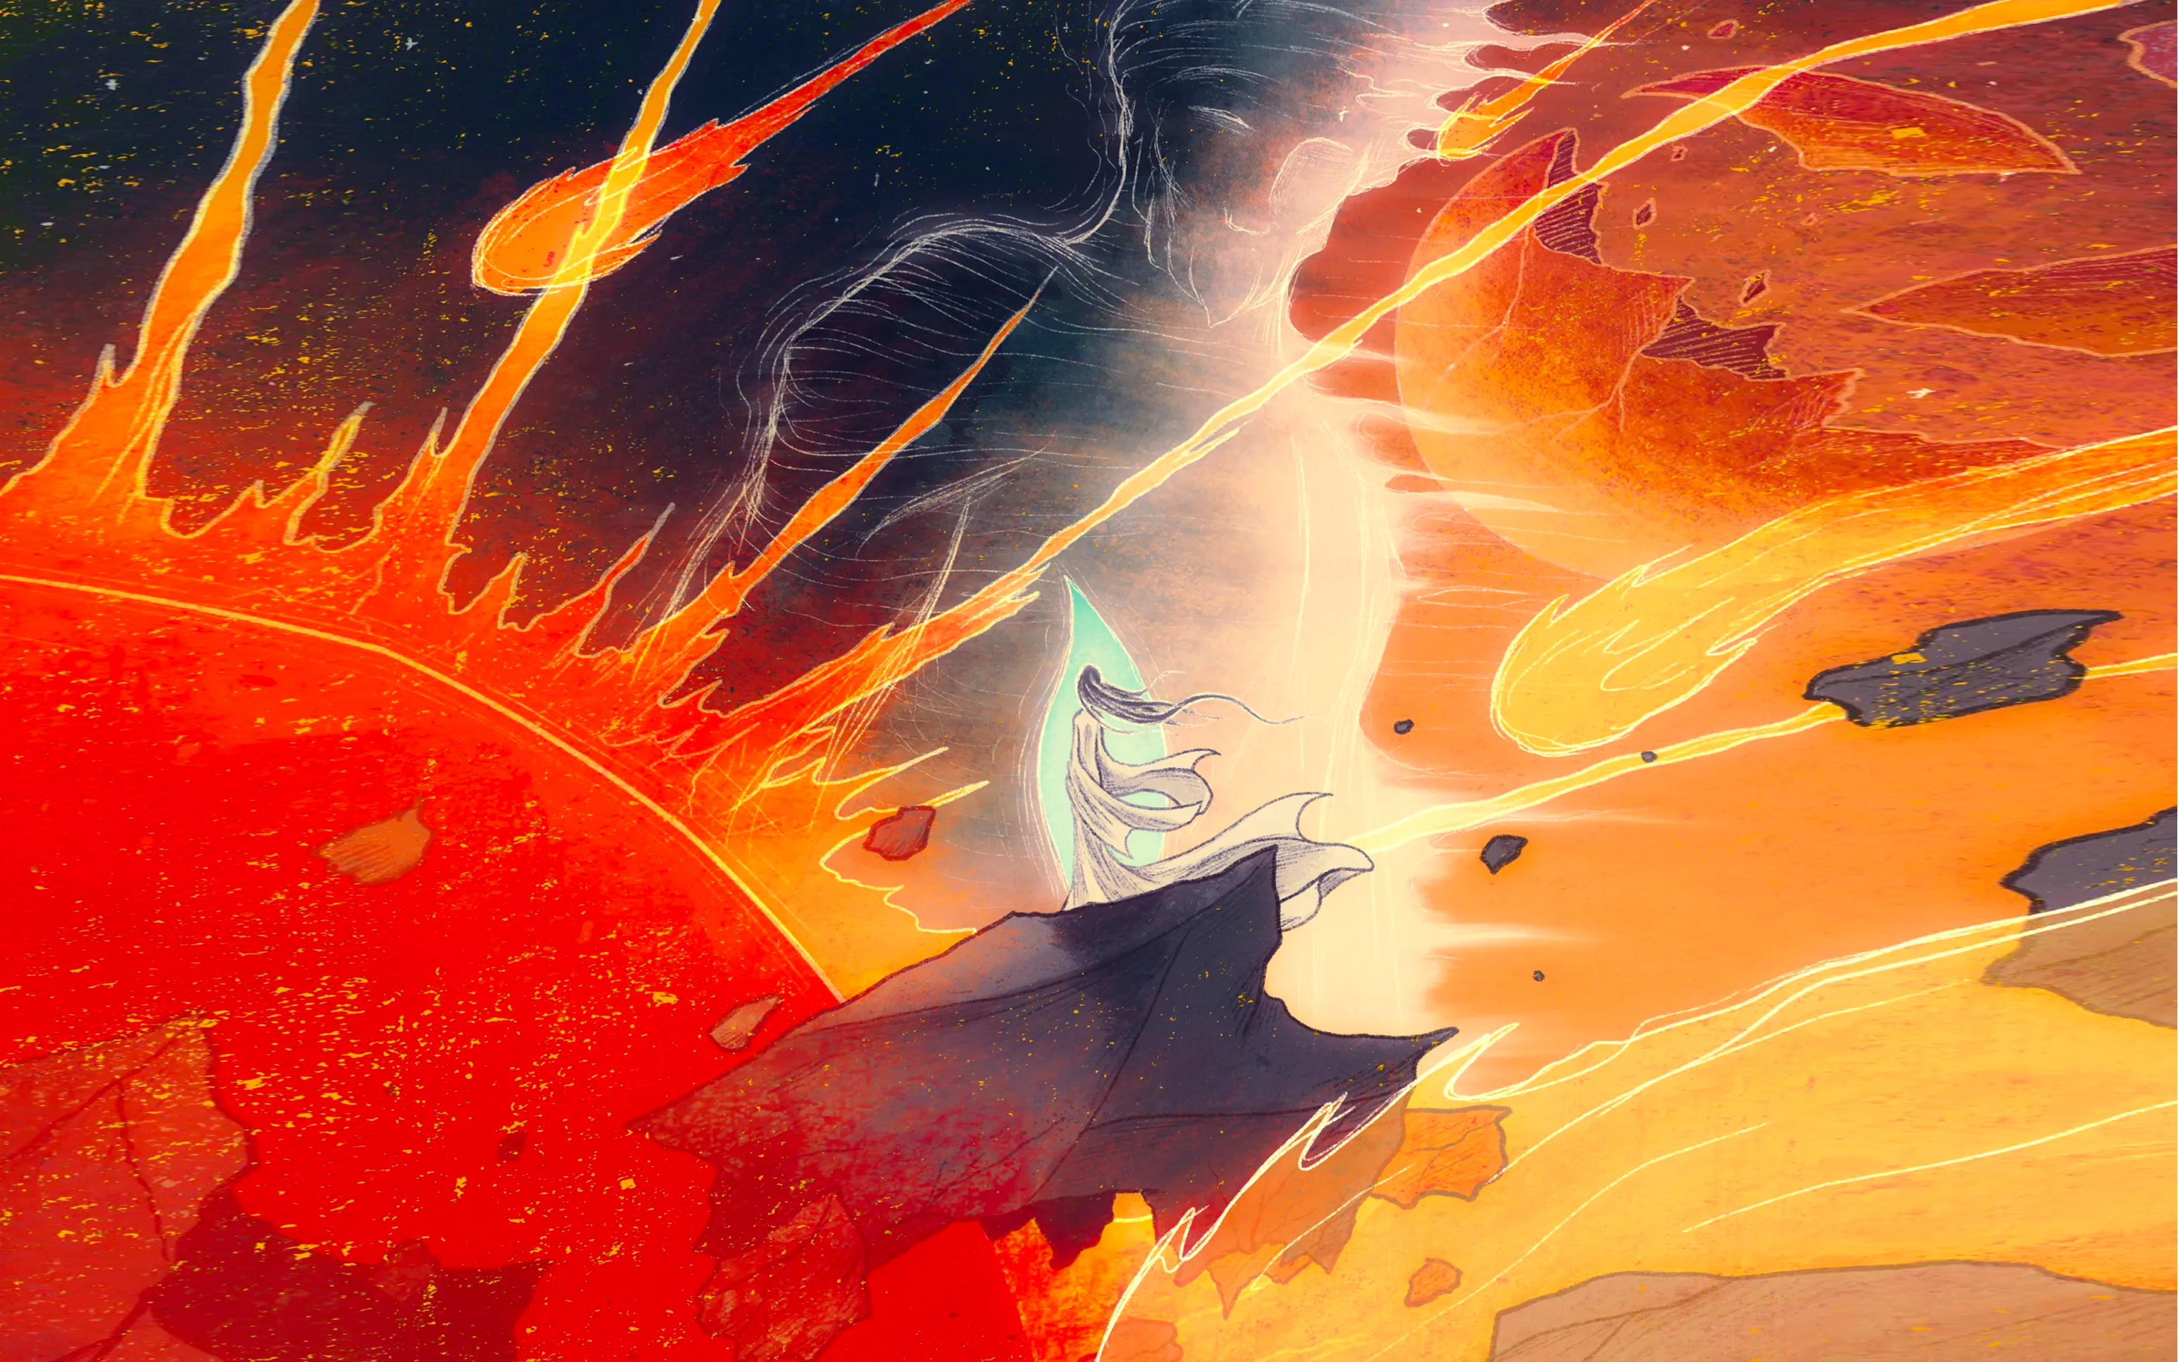
ON HOW TO USE
the Power of God

Slide 4
How many young adults who begin their college years as Christians will by the end lose their faith?
40 %
50 %
60 %
70 %

Slide 5
Barna estimates that roughly 70% of high school students who enter college as professing Christians will leave with little to no faith. These students usually don’t return to their faith even after graduation, as Barna projects that 80% of those reared in the church will be “disengaged” by the time they are 29.
Vaneetha Rendall Risner, “Will You Lose Your Faith in College?”

Slide 6
“Over 80 percent of those who drop out of church do so in the first year of their membership.”
Charles Arn, “Why Churches Don’t Grow”
Notes:
https://www.christianitytoday.com/pastors/2011/june-online-only/whychurchesdontgrow.html
Tons of books and websites offer complex systems and methods for retaining new members, and all of them require tons of hours and lots of dedicated volunteers… Or we can simply cultivate the virtue of agape friendship.
Why do people drop out? Biggest reason: They’ve been drilled with Law and Gospel in BIC, they’re now ready to share that Law and Gospel with others. But when they share that law and gospel with their unbelieving friends, they find out they’re going to lose friends. And if they haven’t made new friends to replace them, it’s far easier to forget about the faith than lose a close friend.

Slide 7
THREE TYPES OF DOUBT
Factual Doubt.
Emotional doubt. 80% of doubters.
Volitional doubt. Willful choice to cut oneself from God.

Slide 8
How can you help a person with reasonable doubt?
How can you help a person with emotional doubt?
What applies to both, regardless of the kind of doubt?

Slide 9
POINT:
What’s far more important than having the right apologetic answers is drawing a person into a Christian community of friends who seeks the answers together.

Slide 10
Faith comes from hearing the message, and the message is heard through the word about Christ.
ROMANS 10:17

Slide 11
Faith comes from hearing the message, and the message is heard through the word about Christ.
ROMANS 10:17
The message of the cross… is the power of God.
1 CORINTHIANS 1:18

Slide 12
Faith comes from hearing the message, and the message is heard through the word about Christ.
ROMANS 10:17
The message of the cross… is the power of God.
1 CORINTHIANS 1:18
Praise be to the God and Father of our Lord Jesus Christ, the Father of compassion and the God of all comfort, ⁴ who comforts us in all our troubles, so that we can comfort those in any trouble with the comfort we ourselves receive from God.
1 CORINTHIANS 1:3-4

Slide 13
Praise be to the God and Father of our Lord Jesus Christ, the Father of compassion and the God of all comfort, ⁴ who comforts us in all our troubles, so that we can comfort those in any trouble with the comfort we ourselves receive from God.
1 CORINTHIANS 1:3-4
Q | I have the community. But how do I actively comfort with God’s Word?

Slide 14
. RE-ALIGNING WITH THE WORD
You have nothing to worry about. God is in control.
You have nothing to worry about. God is in control, and to him you’re the most precious thing in the world. And you know that, because he died and rose and reigns for you.
“Therefore I tell you, do not worry about your life, what you will eat or drink; or about your body, what you will wear. Is not life more than food, and the body more than clothes? Look at the birds of the air; they do not sow or reap or store away in barns, and yet your heavenly Father feeds them. Are you not much more valuable than they? …do not worry about tomorrow, for tomorrow will worry about itself.”
MATTHEW 6:25-26,34
Notes:
These were listed during COVID for our teachers to tell students

Slide 15
. RE-ALIGNING WITH THE WORD
Take a deep breath, be still, and remember who God is.
Your God is the creator of this universe, who brought Israel out Egypt through the Red Sea, who fed the five-thousand, who brought Lazarus back to life, who rose from the dead, and who now sustains all things at the right hand of God.
“The Lord will fight for you; you need only to be still.”
EXODUS 14:14
Notes:
Hospitals, before surgery

Slide 16
. RE-ALIGNING WITH THE WORD
God is with you, and he’ll always be with you.
No matter what’s going on in your life and in the world, you know your God who died for your sins and now reigns in heaven is with you.
“Be strong and courageous. Do not be afraid or terrified because of them, for the Lord your God goes with you; he will never leave you nor forsake you.”
DEUTERONOMY 31:6

Slide 17
. RE-ALIGNING WITH THE WORD
God is working this out for our eternal good.
Whatever things look like in life, we know God is making it work out for his good, eternal plan. So, you never have to worry that things won’t work out according to your loving, forgiving God’s plans for you.
And we know that in all things God works for the good of those who love him, who have been called according to his purpose.
ROMANS 8:28

Slide 18
. RE-ALIGNING WITH THE WORD
This will pass.
The hardships we experience as Christians is temporary. We can honestly say to each other, as Peter did, that our suffering will only be for “a little while.” (1 Peter 1:6)
Dear friends, I am not writing you a new command but an old one, which you have had since the beginning. This old command is the message you have heard. Yet I am writing you a new command; its truth is seen in him and you, because the darkness is passing and the true light is already shining.
1 JOHN 2:7-8

Slide 19
“The heavens and the earth will pass away, but my words will never pass away.”
MARK 13:31

