Slide 1

Taking the Gospel
“To the Ends of the Earth”
WELS Missions

Slide 2
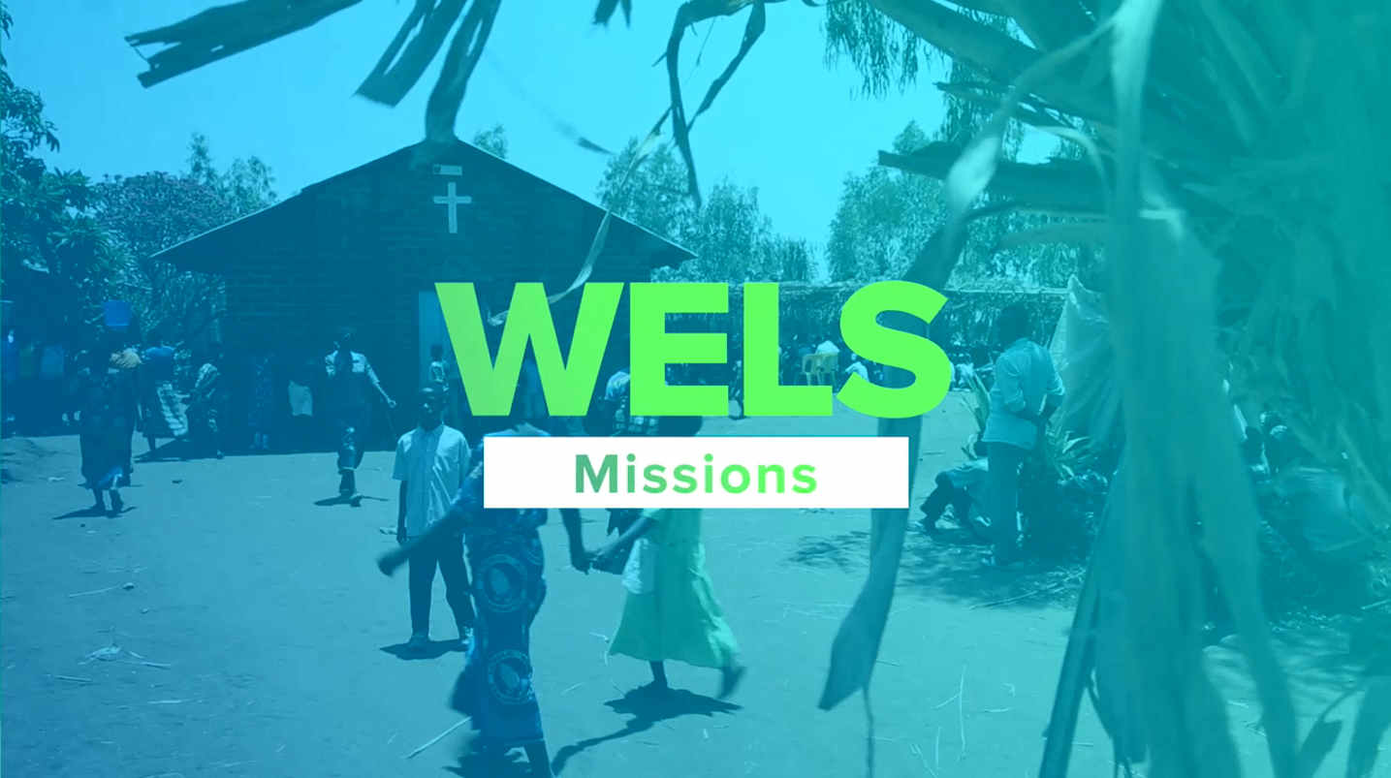
Notes:
Video File: https://vimeo.com/271751018

Slide 3
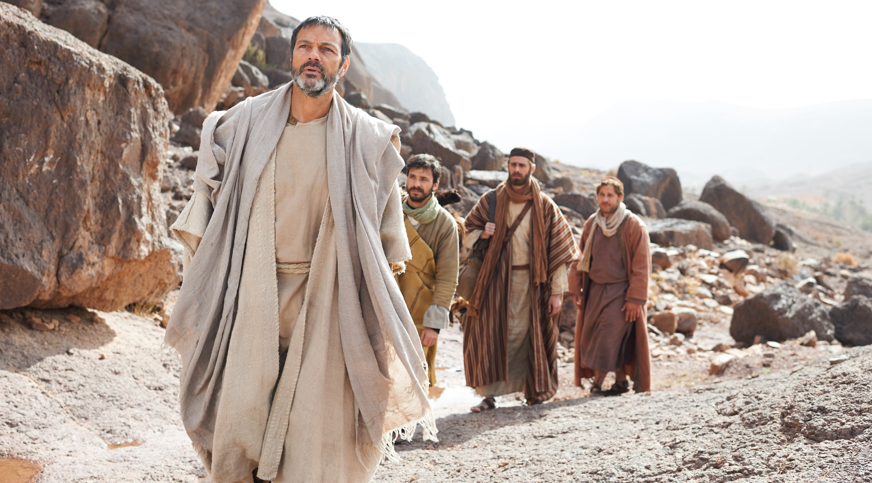


Using technology to reach
all ends of the earth

Slide 4
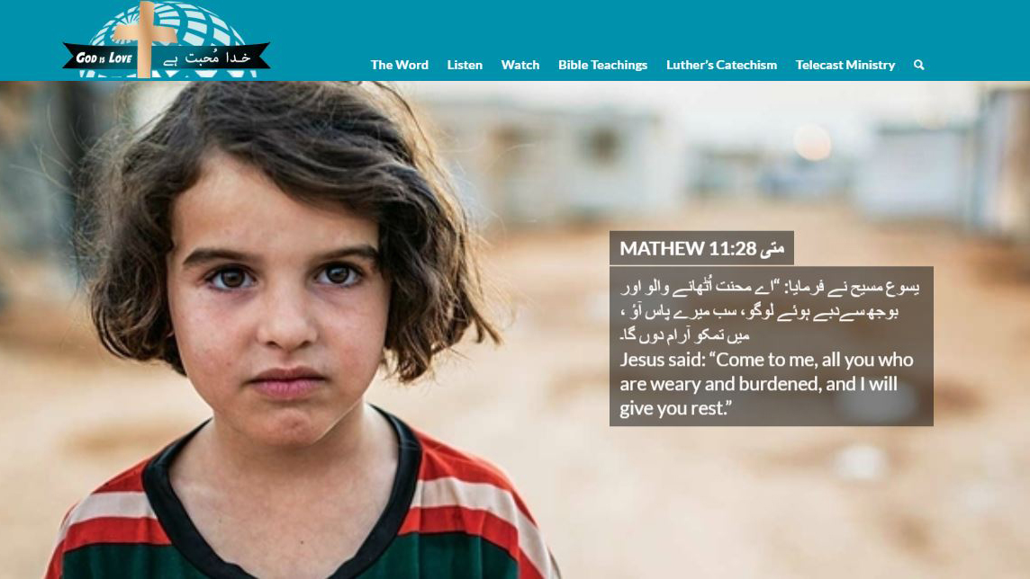
Urdu website reaches Pakistan, where we otherwise
could not go due to security concerns
Notes:
While security concerns prevent missionaries from living in the country or visiting regularly, the gospel is still being shared through Multi-Language Publications efforts. Print materials are frequently distributed, and a Christian TV station preaches the Word in it’s truth and purity (you can view episodes on the “Telecast Ministry”). The website used for outreach can be viewed at https://godsolovestheworld.net/

Slide 5
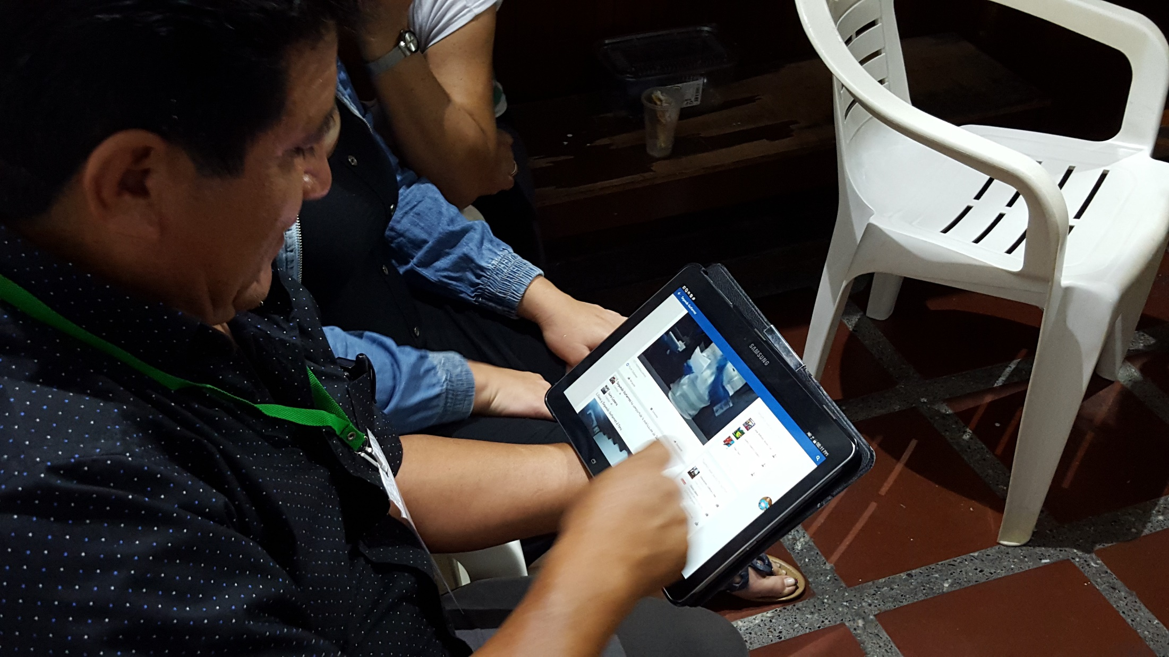
Academia Cristo Facebook page reaches
1 million followers in Latin America with the gospel
Notes:
Academia Cristo:
The goal of Academia Cristo is to empower Spanish speakers to know Jesus, share Jesus, and go with Jesus
The Academia Cristo Facebook page has followers in every Spanish-speaker country around the world
Reach is between 1 to 2 million people per week
4,000 people are asking for online courses
More than 150 people are active in the Heme Aqui (Here I Am) five-week live online course right now

Slide 6
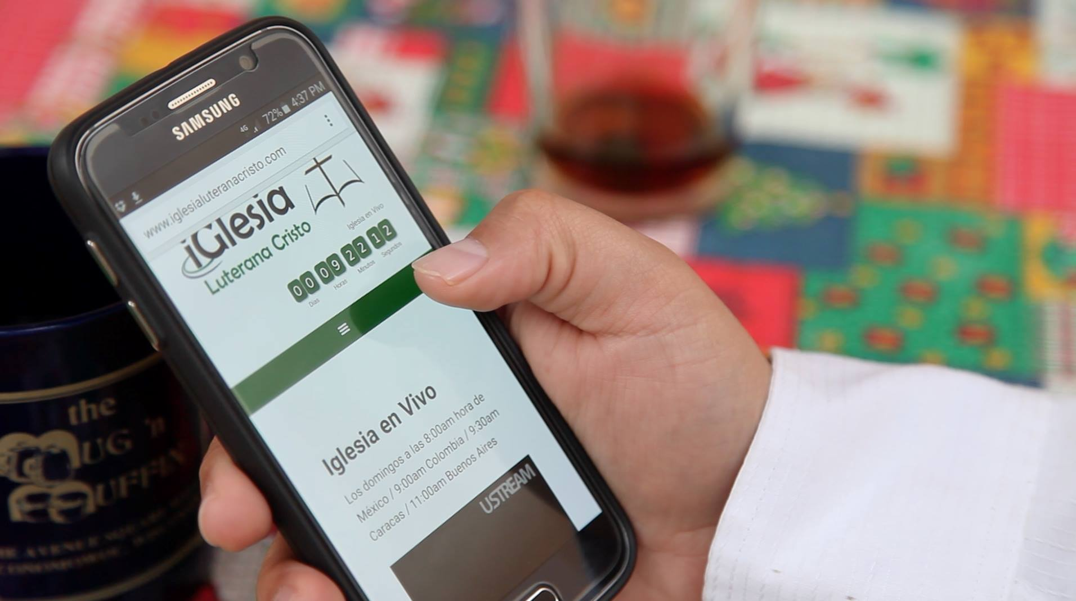
2 million people have downloaded resources;
4,000 people are asking for online courses
Notes:
More Information: https://wels.net/latin-america-mission-updates/

Slide 7

Notes:
Watch the Academia Cristo June Update Video: https://vimeo.com/274180060?ref=em-share

Slide 8
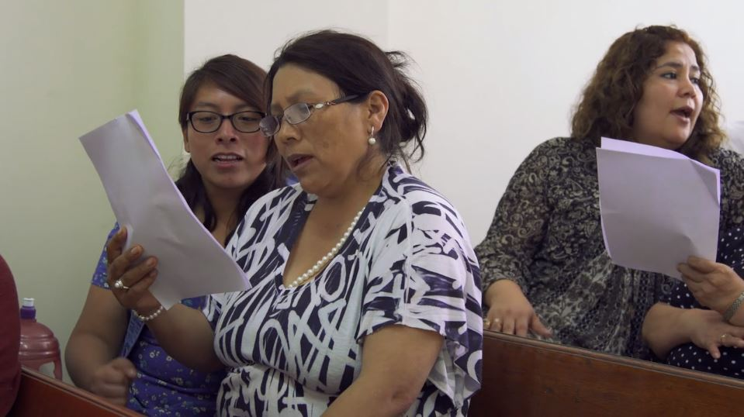
Ethnomusicology: Connecting people with the gospel through culturally-appropriate music (Video)
Notes:
Video: https://vimeo.com/album/4544849/video/214081336

Slide 9
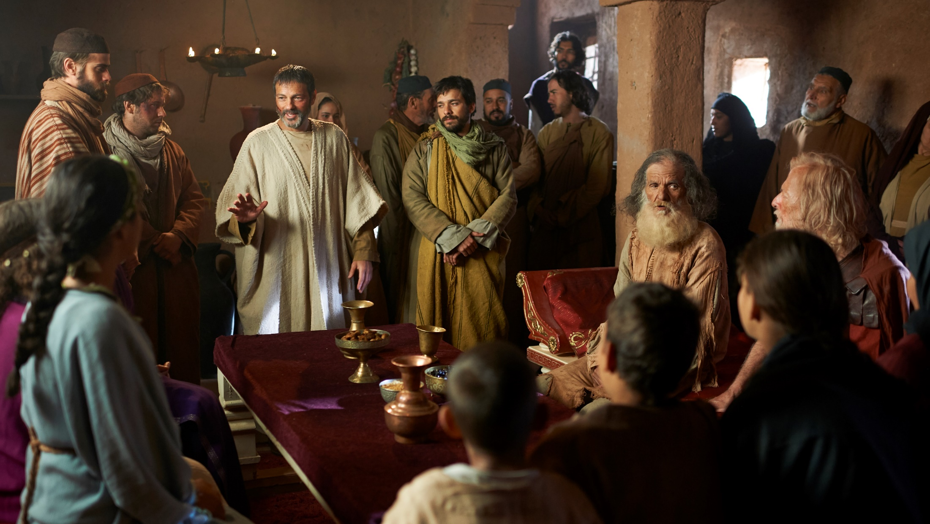

Theological training around the world

Slide 10
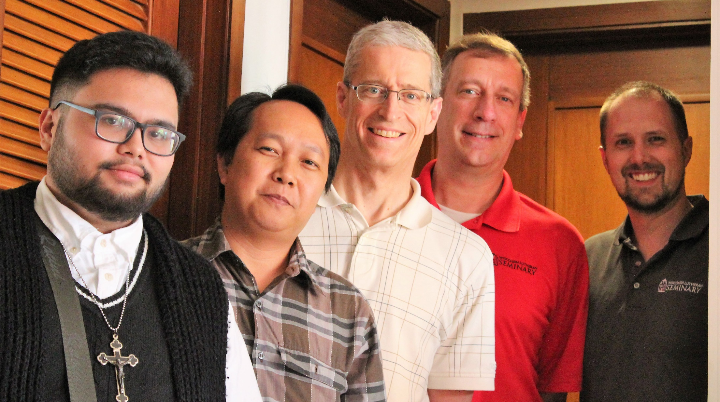
PSI trains spiritual leaders in places like the Philippines, Vietnam, Mexico, Malawi, and Nepal
Notes:
Photo: From a recent training visit to the Philippines - Prof. Brad Wordell (second from right) and Prof. Jon Bare, PSI International Recruitment Director (right) are two of the three men that make up the Pastoral Studies Institute (Prof. Al Sorum serves as Director of the PSI program – he was pictured teaching in the introductory video)
The Pastoral Studies Institute (PSI) of Wisconsin Lutheran Seminary, in partnership with WELS Joint Mission Council, guides and assists non-traditional students through their pre-seminary and seminary training, providing a flexible path to ministry. The PSI has connected with students through congregational ministry to immigrants and refugees here in the United States and Canada, as well as through WELS world mission work. The PSI is able to evaluate and serve these groups that want support, training, and a connection to a church body that shares the gospel message in its truth and purity.
More Information:
https://wels.net/missions-newsletter2017-psi/

Slide 11
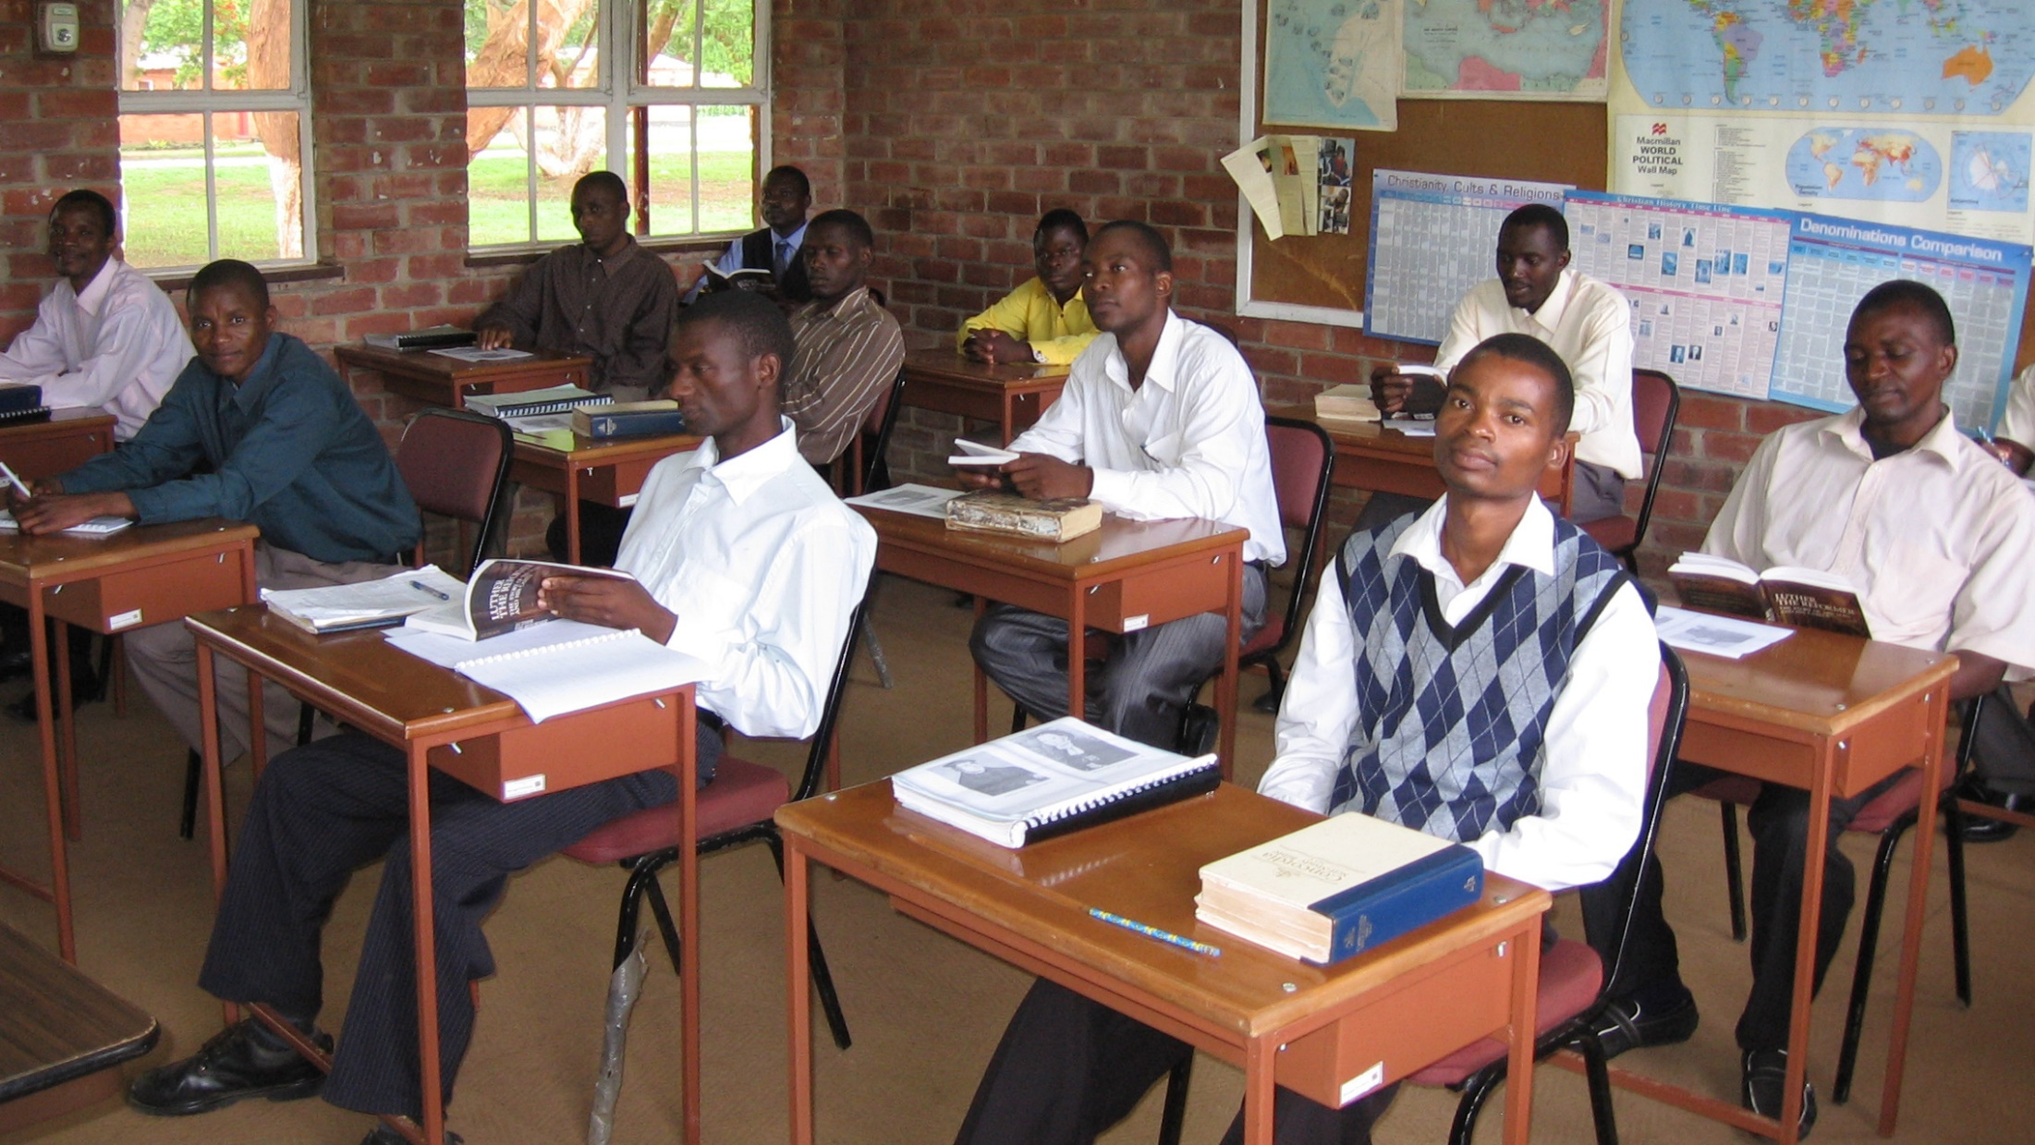
Lutheran Church of Central Africa operates a Lutheran Bible Institute (Malawi) and Seminary (Zambia)
Notes:
The Lutheran Church of Central Africa (LCCA) has two training centers. The Lutheran Bible Institute in Malawi and the Lutheran Seminary in Zambia. These two theological Schools are run by both Zambia and Malawi under the Joint Worker Training Board. Candidates for the Pastoral ministry are identified from the congregations through the process known as “Theological Education by Extension’ (TEE). After the Theological Education by Extension they are sent to the Lutheran Bible Institute for three years. From there students are sent to the Lutheran Seminary for another three years. Finally graduating students are posted for one year to serve as Vicars. After this practical year these students are then ordained as Pastors.

Slide 12

Notes:
Video: https://vimeo.com/album/4102400/video/215580721
More Information: https://wels.net/new-school-year-at-asia-lutheran-seminary/
Stats/Highlights:
Asia Lutheran Seminary celebrated 13 years of operation in September 2017
15 students taking 3-week intro immersion course to Hebrew
4 full-time students in Hong Kong, 1 in India, 10 in Mainland China
50 other students taking classes part time in Hong Kong
60 taking courses via the online program

Slide 13
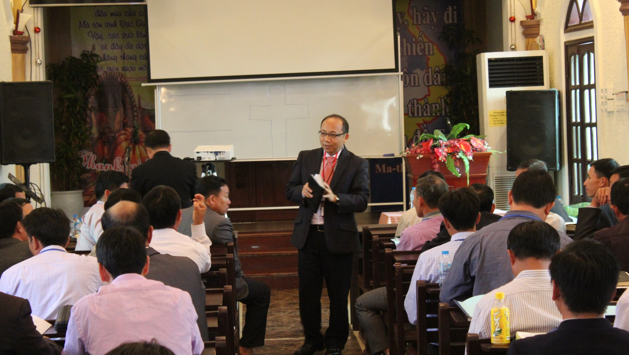
Vietnamese government has invited WELS to build a theological training facility in Hanoi
Notes:
VIETNAM:
Rev. Bounkeo Lor (pictured) serves as Hmong Asia Ministry Coordinator, called through the Global Hmong Committee. Originally a pastor in Kansas City, KS, a leader of the Hmong Fellowship Church (HFC) in Vietnam found one of Pastor Lor’s sermons online and reached out for training. Since then, Pastor Lor has been making about 4 trips per year to train leaders of the Hmong Fellowship Church (HFC). The HFC has grown from 65,000 to 100,000 members in three years WELS has been providing training through Pastor Lor and the PSI program. 50-60 top HFC leaders attend training whenever it is offered and then take it back to the other 250 pastors.
Highlights
WELS is currently the only protestant church with official permission to work with the Hmong in Vietnam
The communist Vietnamese government has invited WELS to purchase land to build a seminary/training center in Hanoi, Vietnam
Many of the HFC churches are now calling themselves Lutheran
Missions representatives are visiting Vietnam in early June to explore this opportunity and finalize plans for the training center.
More Information:
https://wels.net/exciting-ministry-opportunity-vietnam/
https://wels.net/the-lord-blesses-hmong-outreach-in-vietnam/

Slide 14
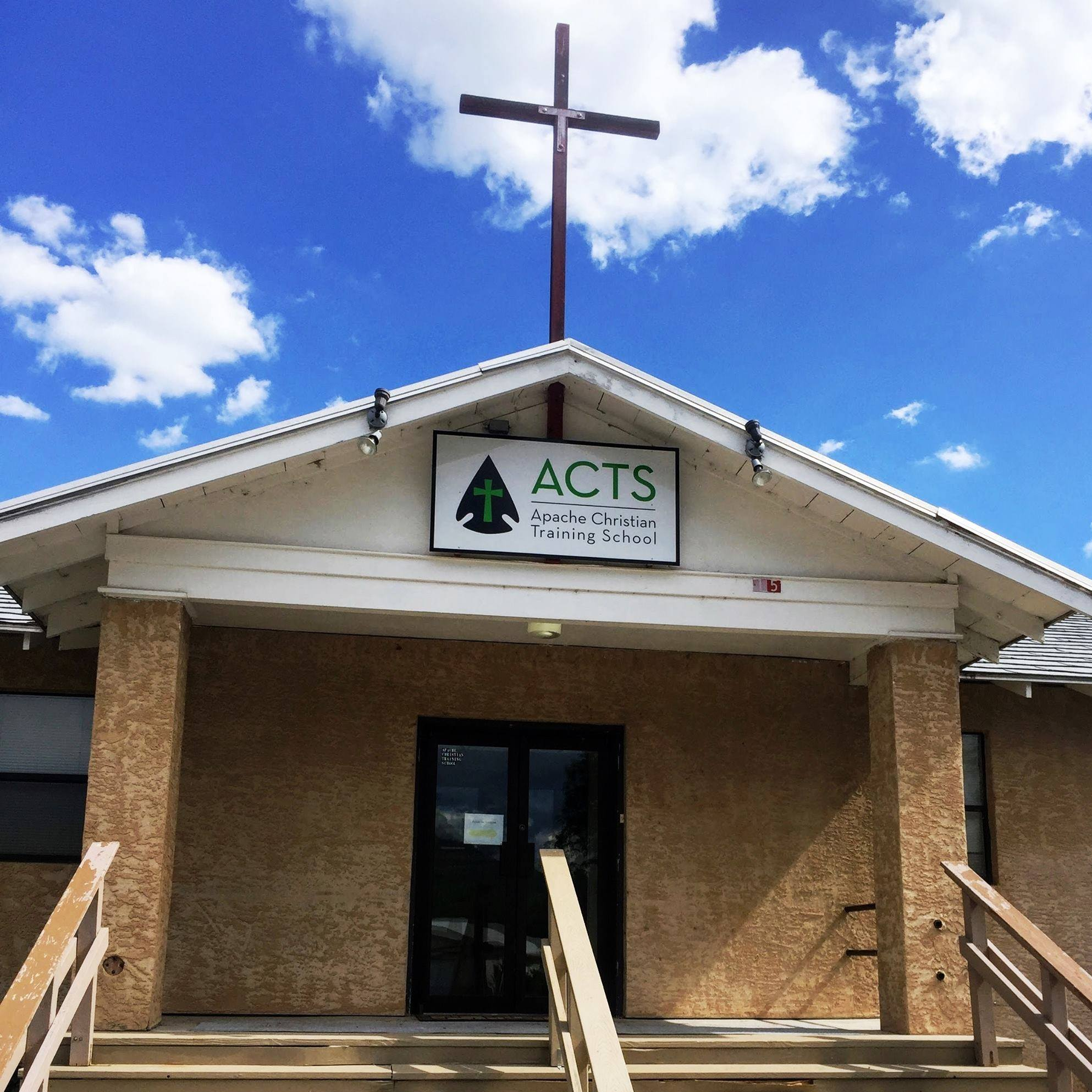
Apache Christian Training School (ACTS) –
Preparing pastors and evangelists
Notes:
Apache Reservation - 9 congregations, 2 grade schools, 1 high school – approx. 3600 members
ACTS – Chosen as one of three special 125th Anniversary Projects:
Apache Christian Training School:
Apache Christians are asking to be equipped to share Christ’s love. ACTS provides them with training and resources that prepares leaders for all levels of ministries on the reservations. With a solid program already in place, ACTS exists to provide trained workers for the ever-expanding ministries of current congregations. ACTS will also play a key role in the training of workers to share the gospel with other Native American communities.
Future Outreach:
New website – nativechristians.org – will connect Apache Christians across the 4-million-acre reservation to prepare all church members for personal evangelism. The next step would be to being outreach to the 535 other Native American tribes in North America
Article: https://wels.net/native-christians-look-to-the-future/
Forward in Christ Articles:
April 2018: https://wels.net/reaching-native-christians/
May 2018: https://wels.net/reaching-native-christians-part-2/
June 2018: https://wels.net/reaching-native-christians-part-3/

Slide 15
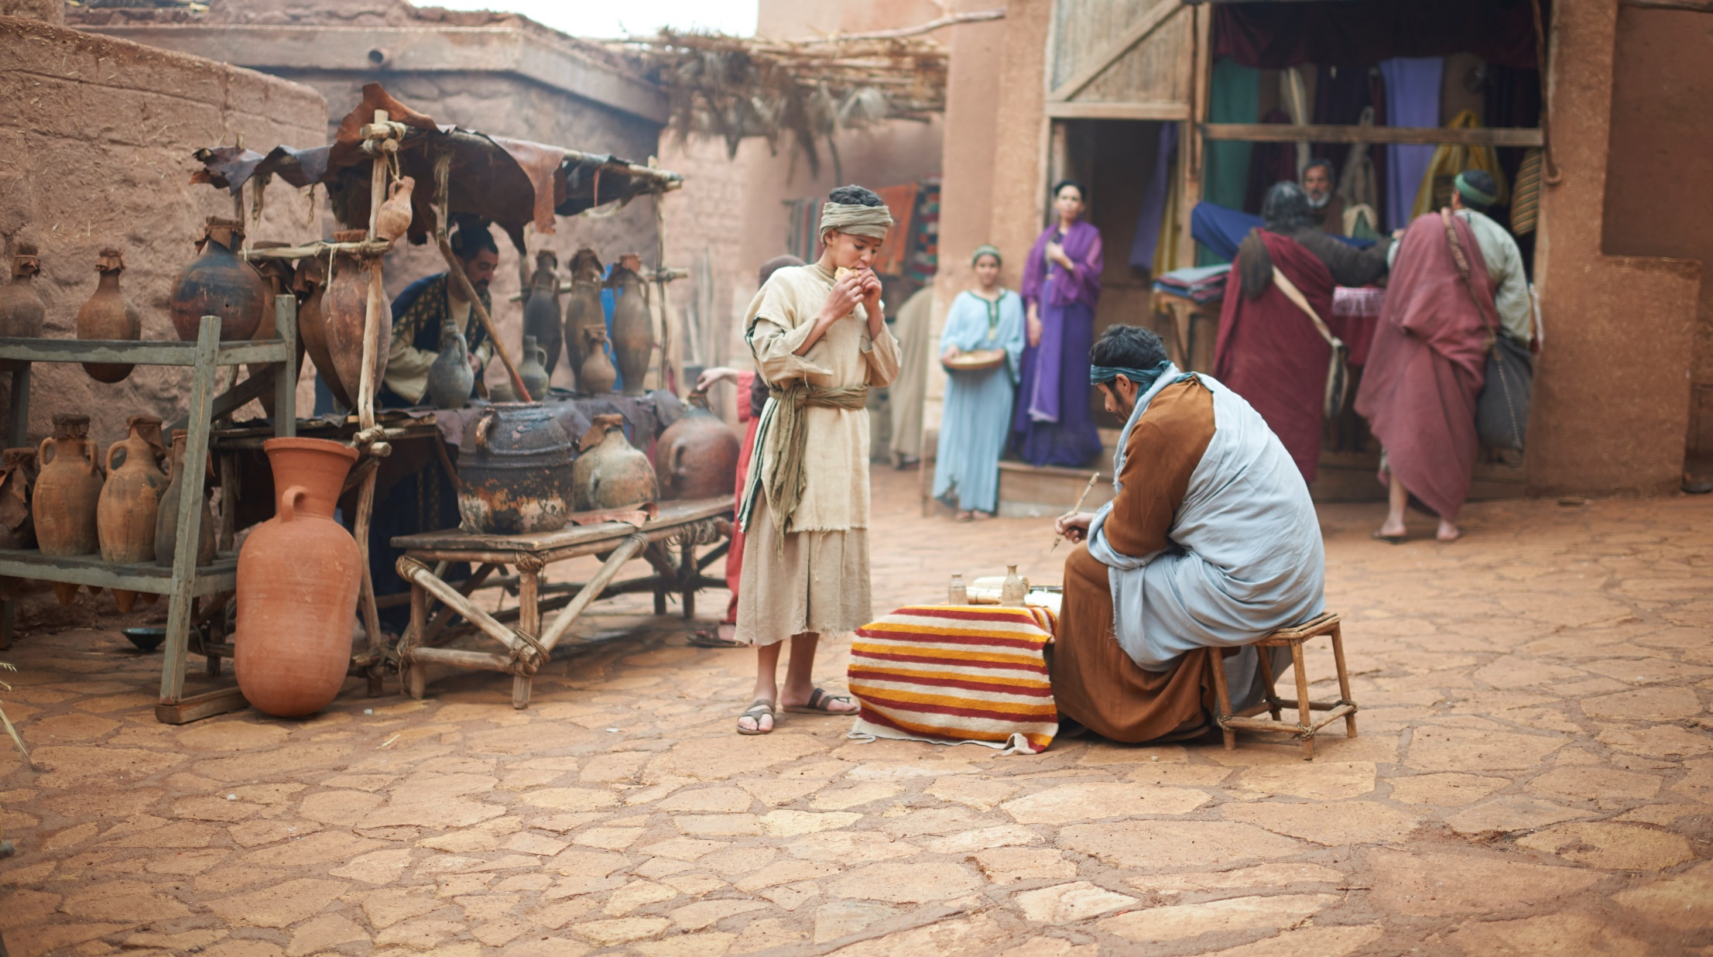
Sharing Christ’s compassion through humanitarian aid
Notes:
“Therefore, as we have opportunity, let us do good to all people, especially to those who belong to the family of believers” (Galatians 6:10).
The mission of Christian Aid and Relief is to reflect Christ’s love and compassion to souls suffering from disasters and hardships. Because of what Christ has freely done for us, we eagerly show we care by offering our time, talents, and treasures to those in need.
With the combining of disaster and humanitarian aid committees, the Lord is giving us new opportunities to show how much we care by bridging the gospel proclamation with acts of compassion. As we provide for people’s physical needs, we open doors for WELS missionaries to share what they know about our Savior and his good news for their lives.

Slide 16
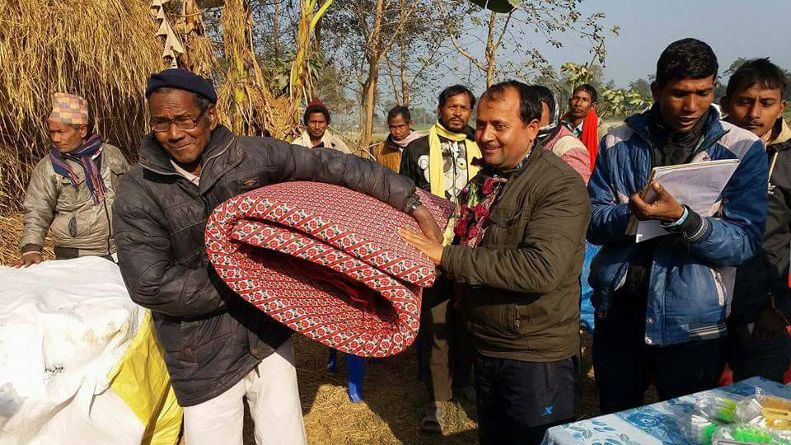
WELS Christian Aid and Relief granted $20,500 to assist with flood relief in Nepal
Notes:
Link to Article: https://wels.net/mlp-continues-to-work-in-south-asia/
Nepal currently has 42 congregations and 14 seminary students. Multi-Language Publications served as the parent of this mission field, planning enough seeds that a church grew. WELS leaders continue to visit to conduct leadership and Bible workshops with local leaders.

Slide 17
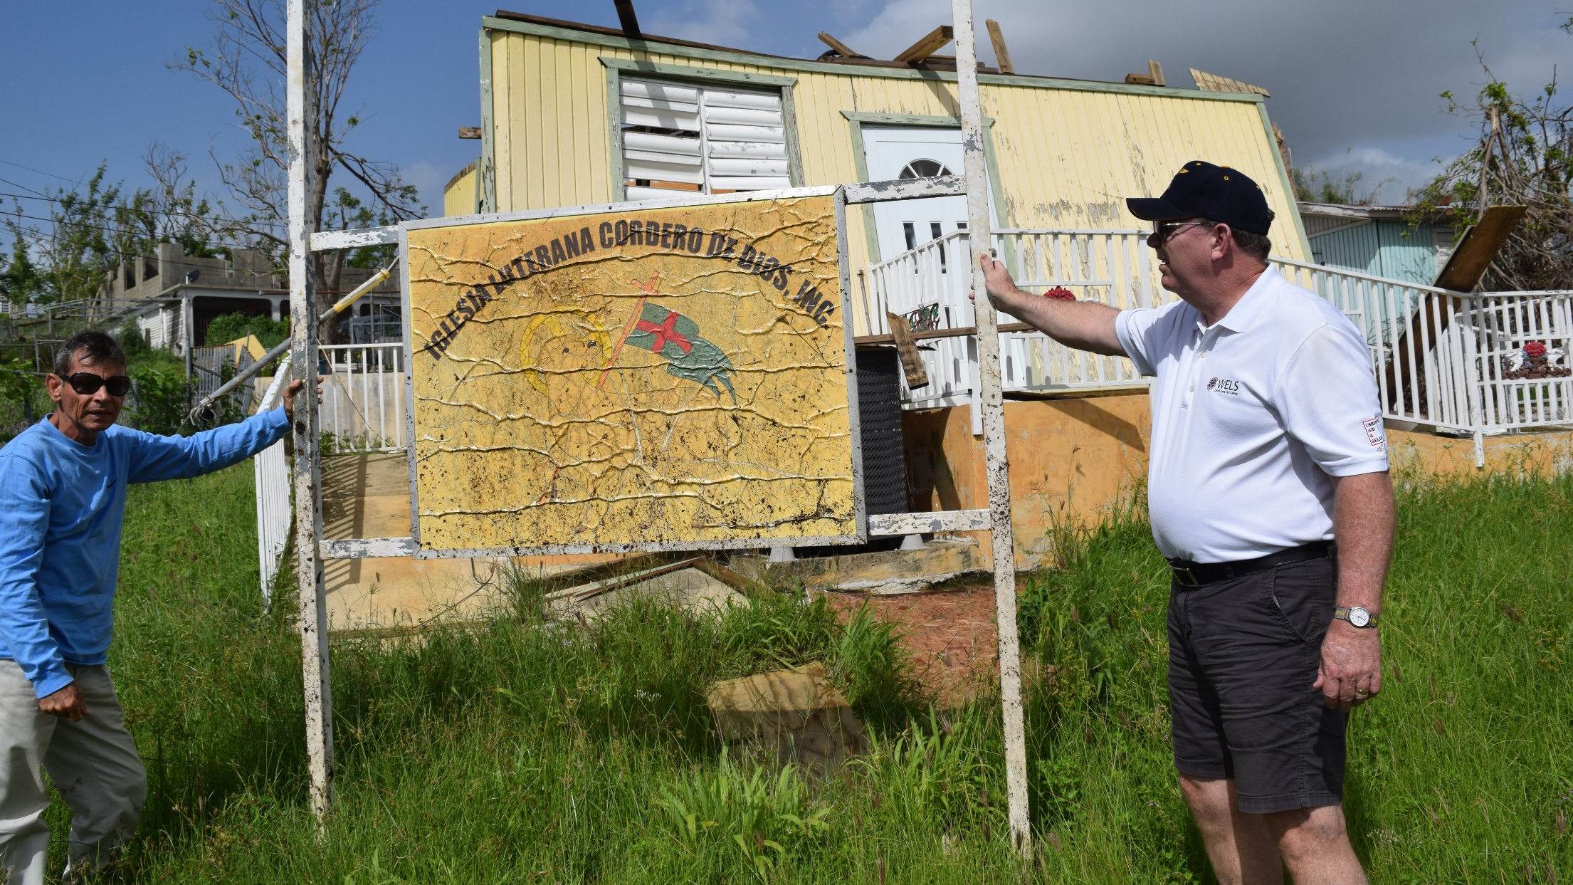
Hurricane relief efforts in Puerto Rico
opens doors for mission work
Notes:
WELS Christian Aid and Relief has called Rev. Larry W. Schlomer as disaster response coordinator for Puerto Rico. He will serve for one year and work with the national pastors of the Confessional Evangelical Lutheran Church of Puerto Rico to identify and prioritize specific needs, plan construction and repair projects, and coordinate volunteer efforts. He will also help to coordinate continuing theological training for two men whose training was interrupted by Hurricane Maria last fall. Rev. Schlomer will be in Puerto Rico from June 2018 – June 2019
More Information: https://wels.net/plans-underway-relief-puerto-rico/

Slide 18
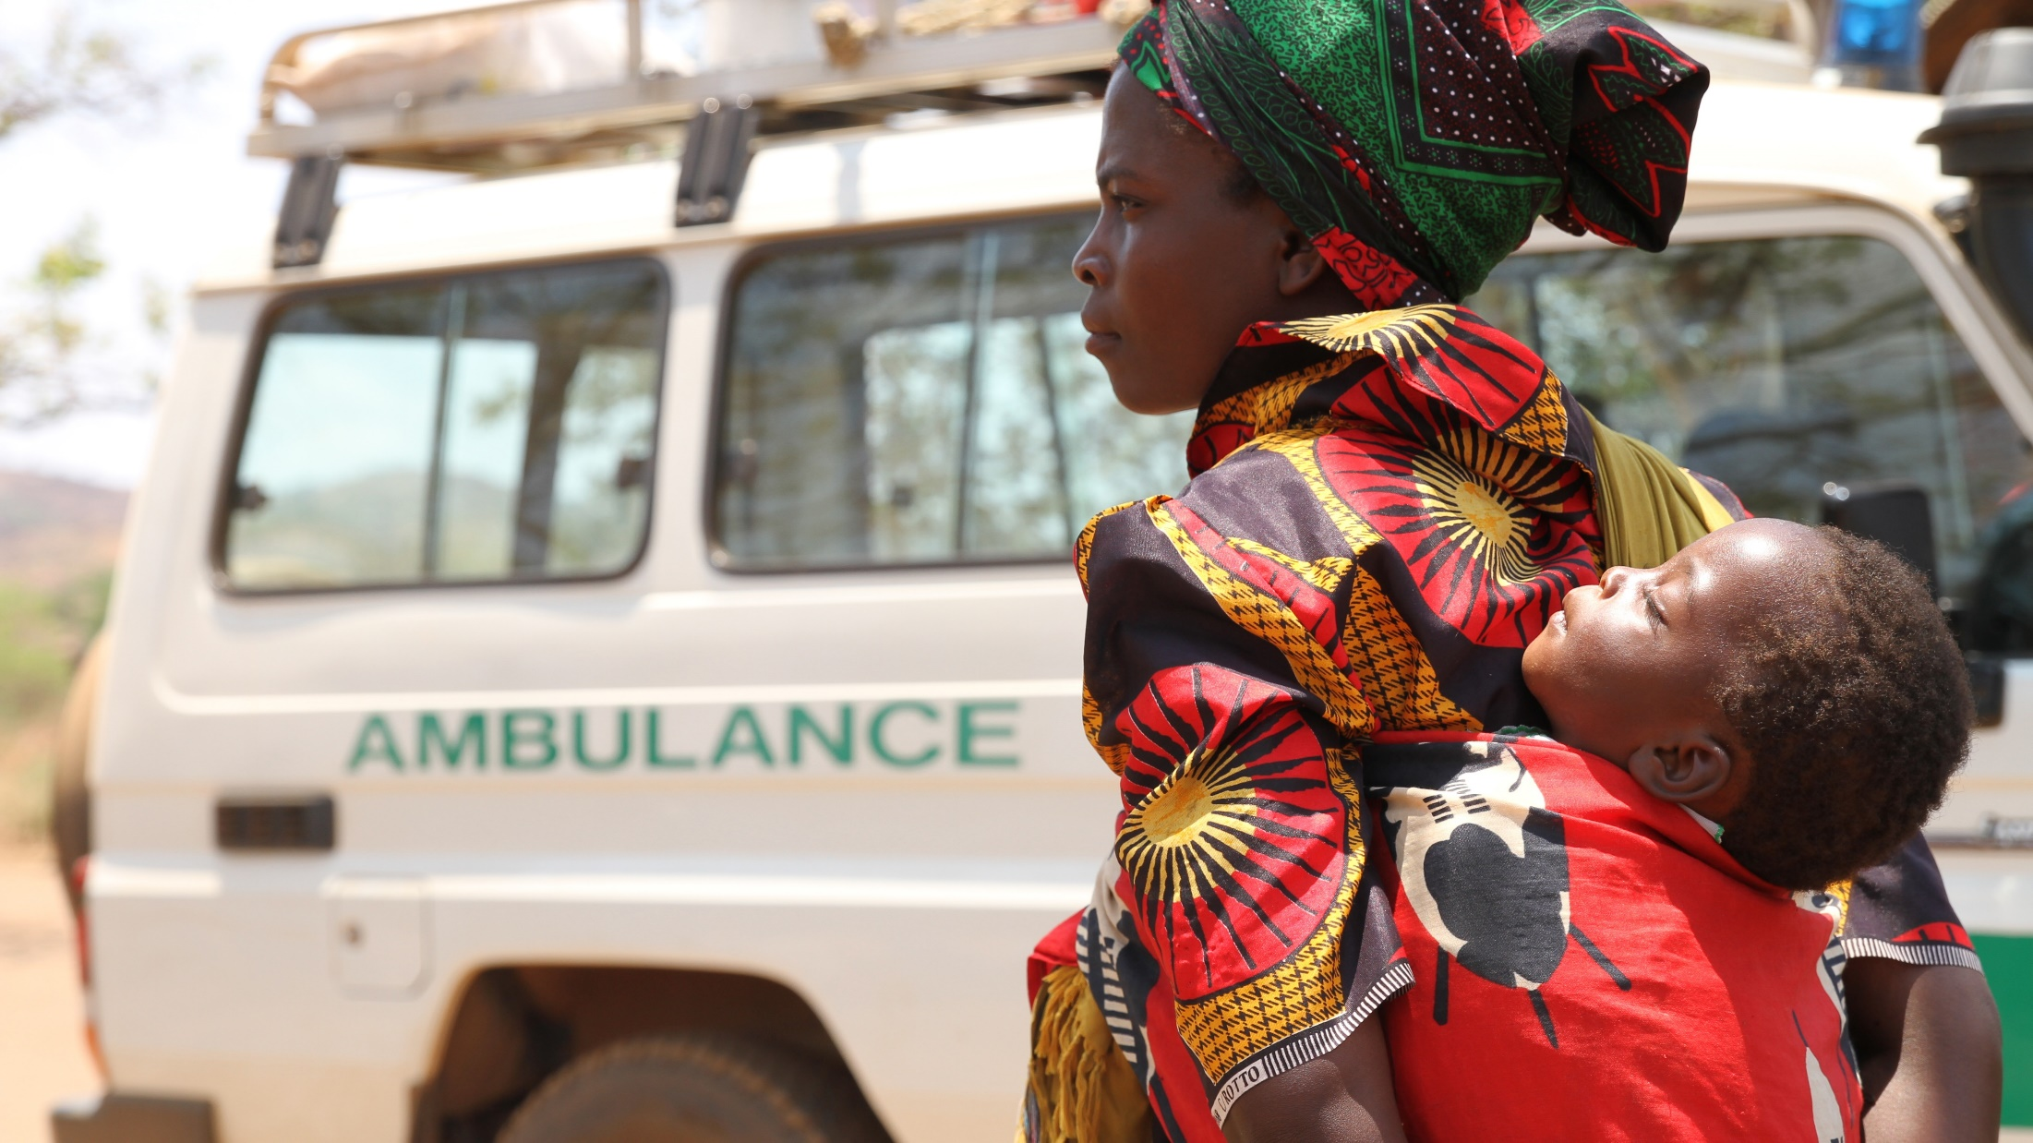
Central Africa Medical Mission (CAMM) shares Christ’s love by providing medical care
Notes:
The Central African Medical Mission (CAMM) started in 1961 in Lumano, Zambia. Today, CAMM oversees a permanent clinic called the Lutheran Mission Rural Health Centre in Zambia on the same property as one of the Lutheran Churches of Central Africa. They also operate the Lutheran Mobile Clinic in Malawi that travels to four different villages throughout the week. The buildings used in these villages serve as clinics during the week and as churches on Sundays. The Zambia clinic is completely run by national health care workers, and the Malawi clinic is served by two U.S. employees who work alongside other nationals. Prior to clinic work starting for the day, a brief devotion is given to all who attend. Both clinics focus on providing Christian counseling and testing for HIV, education and treatment of Malaria, immunizations, wellness education, and treatment of other minor injuries or illness. By partnering with the Lutheran Church of Central Africa and WELS missionaries, we provide help for the spiritual and physical needs of the people in Zambia and Malawi.
CAMM relies solely on donations to continue operation
The Lutheran Mobile Clinic in Malawi saw 43,598 people in 2017
The Zambia clinic hosts Children’s Health Week twice a year to provide Vitamin A and deworming supplements
An average of 13,187 children per year, under the age of 5, are seen for wellness visits and immunizations at the Malawi clinic
6,986 patients tested positive and received treatment for Malaria at the Malawi clinic in 2017
Learn more at www.camm.us. Follow CAMM on Facebook at fb.com/camm.wels.

Slide 19
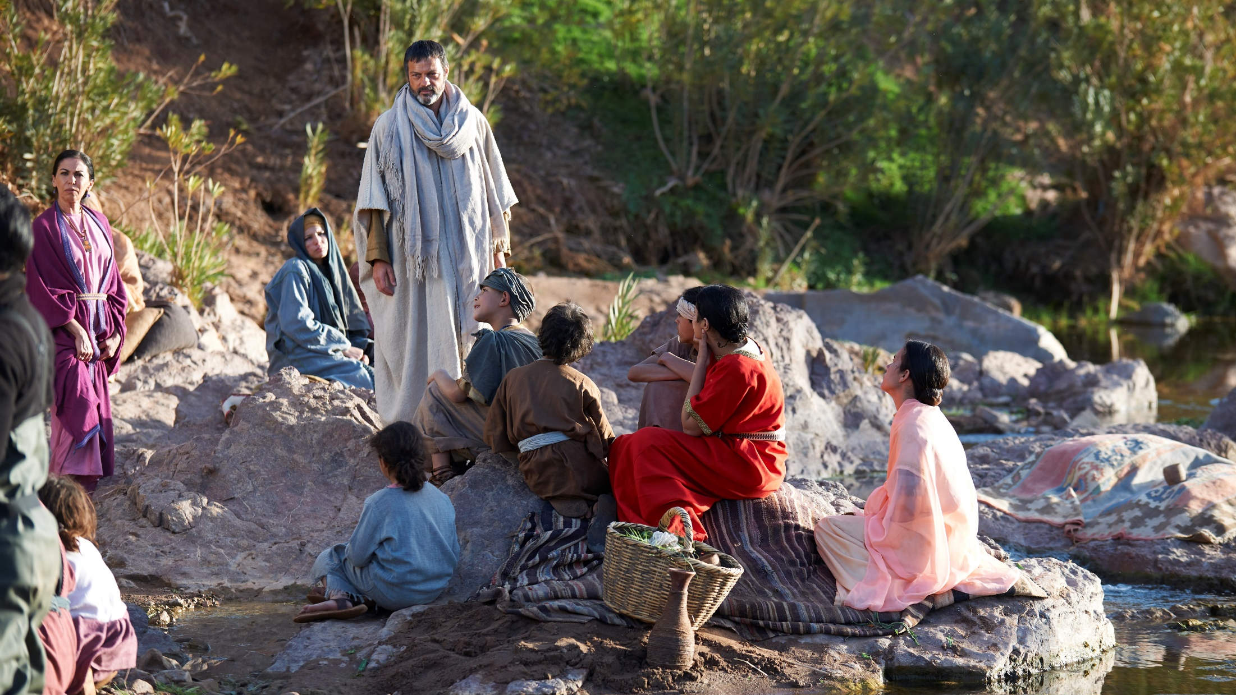
Different methods of outreach –
right here at home

Slide 20
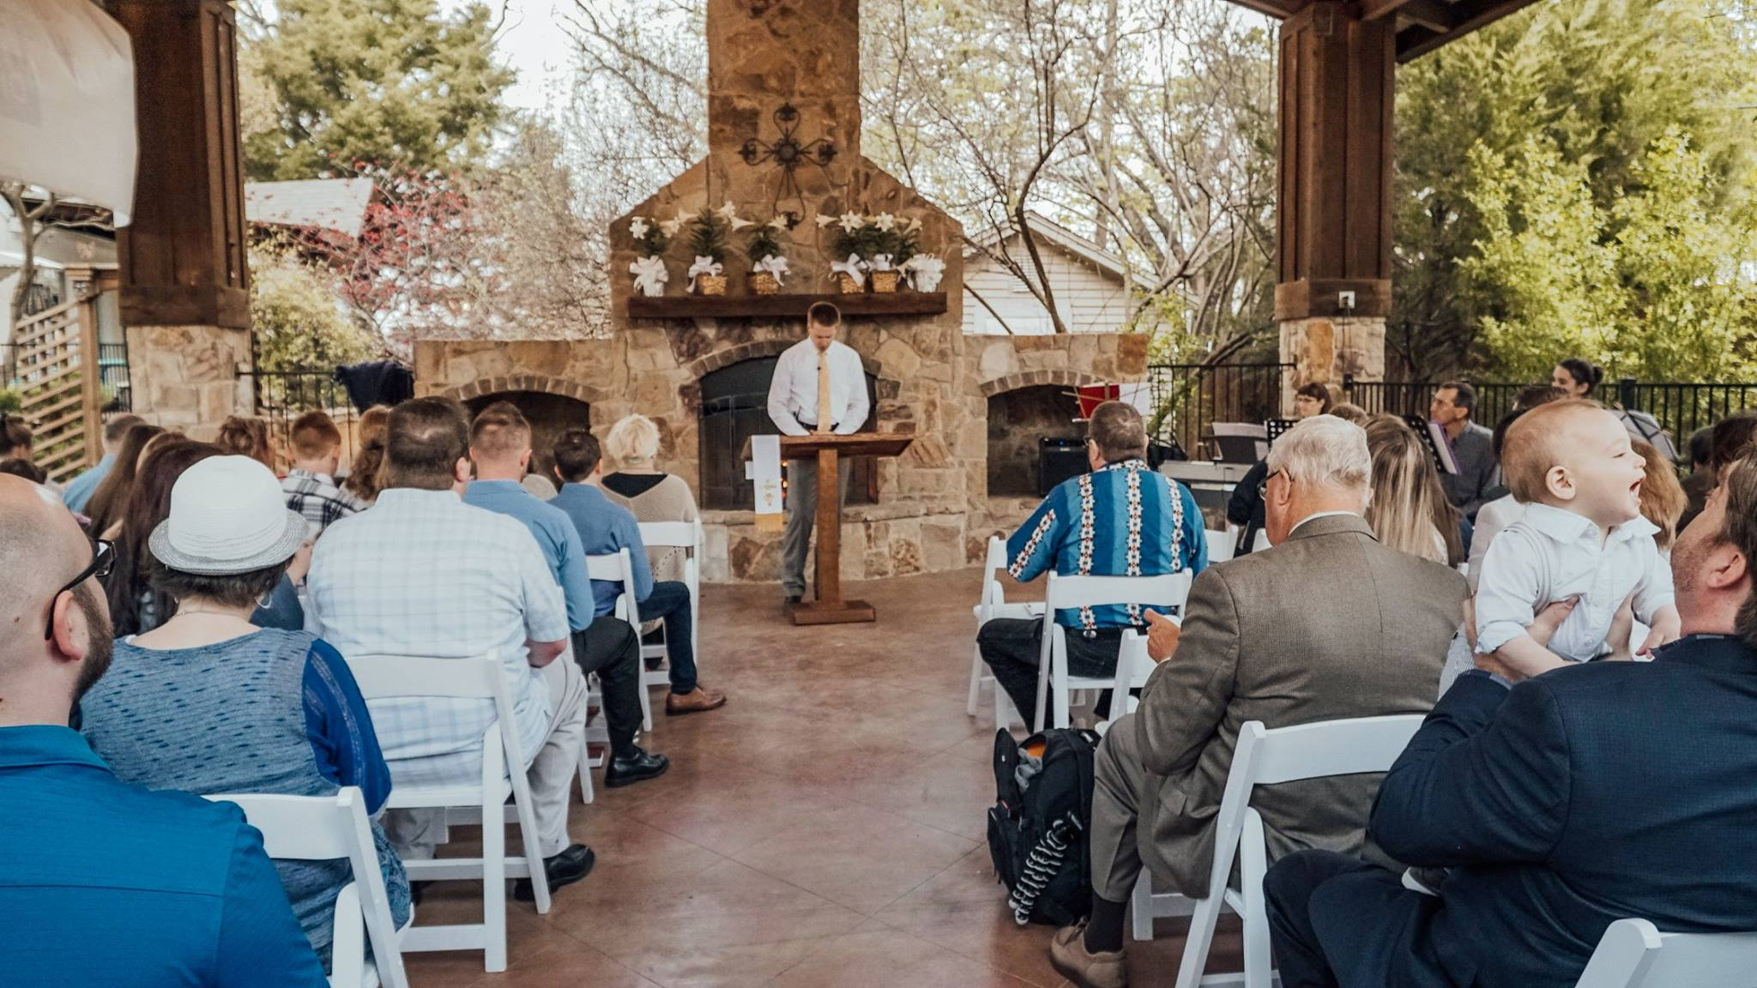
Home Missions - Multi-Site Ministry
One church, 2 campuses
Notes:
Pictured: Divine Peace in Rockwall, TX - This multi-site mission currently has 2 locations for worship. Home Missions funding supported the second pastor for their second site.
The multi-site church movement is all about reaching more people with the gospel, and the potential for this relatively new strategy among WELS congregations is tremendous. Having one church in several locations allows congregations to reach different communities while enjoying practical benefits such as shared resources, efficient organization, and cost-effective programs. The greatest blessing possible is that God would use these ministries to reach more people with the gospel. Some multi-sites are natural outgrowths of mission-minded churches that want to reach out to more people. In other situations, churches were struggling to keep their doors open – and merging with another congregation nearby allowed them to continue reaching out to their respective communities.
Consider attending the WELS National Multi-Site Conference in November to learn more. It is open to all congregational leaders, interested laypeople, and pastors. The conference will include nearly a dozen speakers from some of the most experienced WELS multi-site churches and pastors. Their experience will be valuable for all participants, regardless of their level of multi-site church experience.
More Information:
https://wels.net/its-about-saving-souls/
htthttps://wels.net/one-church-two-locations/

Slide 21
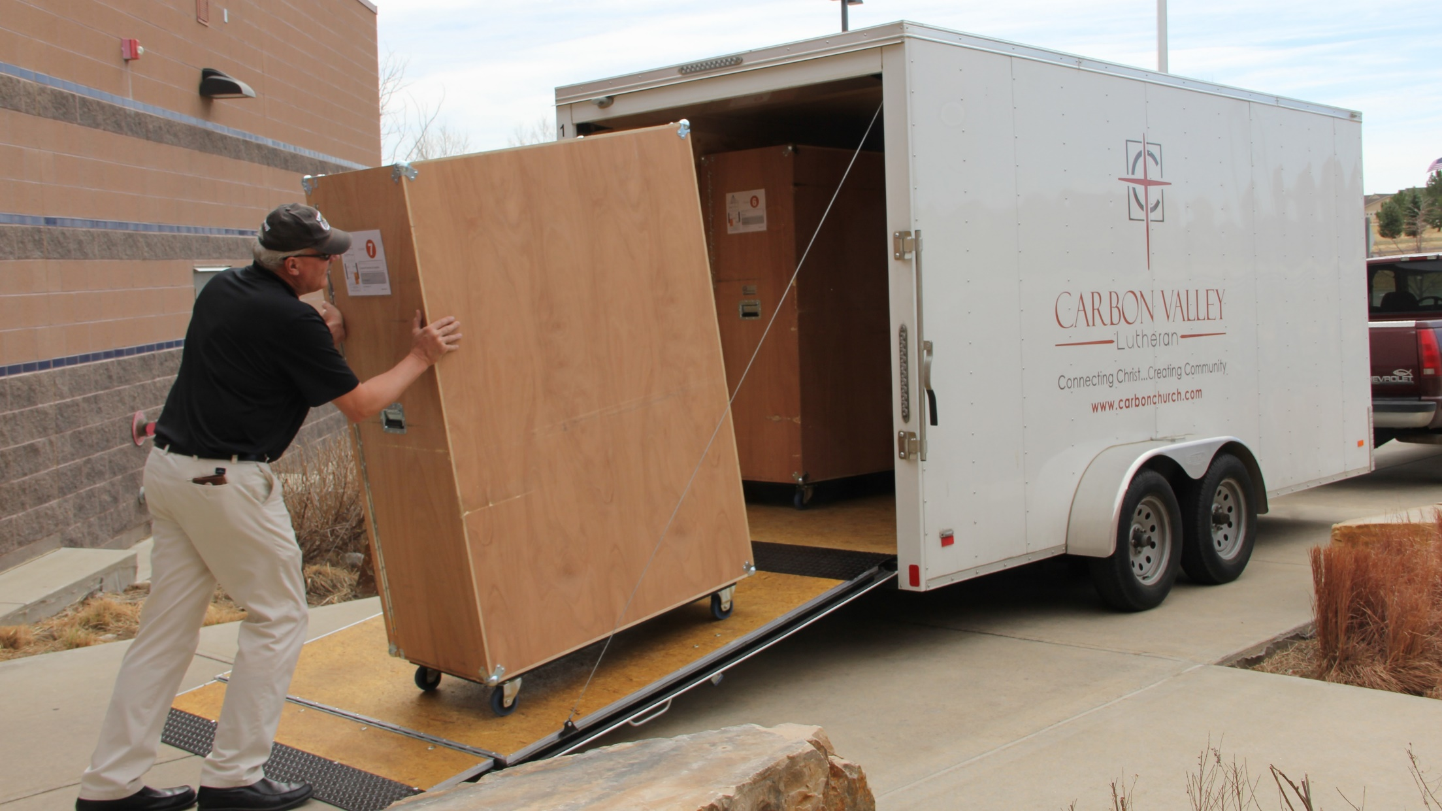

Church in a Box
Flexible solutions for worship
Notes:
WELS Connection Video: https://vimeo.com/album/79546/video/228836577

Slide 22
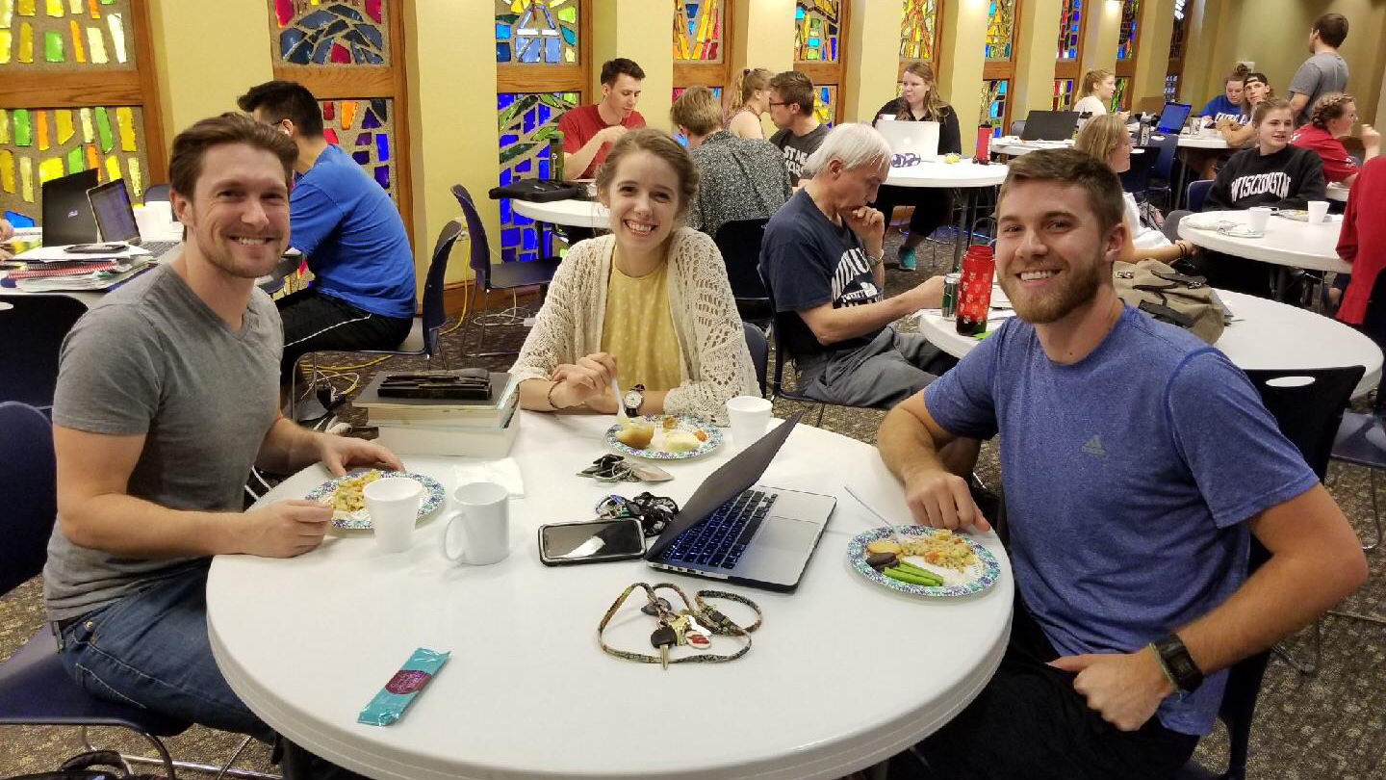
WELS Campus Ministry –
Bringing Christ’s Light to Campus
Notes:
(Pictured: Students from Wisconsin Lutheran Chapel on the UW-Madison campus share finals goodies with other students)
WELS Campus Ministry – A subsidiary of WELS Home Missions
Mission Statement - The Mission of the Campus Ministry Committee (CMC) is to assist congregations in ministering to college students and other young adults with the Means of Grace so they may grow in their faith, be trained for service, and reach out to the lost.
Campus Ministry
WELS is involved in more than 550 campus ministries across the United States and Canada.
Includes any ministry to college students on a secular university campus – including congregations supporting their own students while they are away at college.
Also includes congregations serving students attending universities near their congregation
What Can You Do?
Provide the Campus Ministry Committee with update contact information for college students at www.wels.net/campus-ministry
Welcome college students in your area to your congregation
Help start or support an organized Campus Ministry at your church
Pray that the Lord would keep college students close to him through regular worship and bible study.
Encourage your congregation to remember Campus Ministry with special offerings

Slide 23
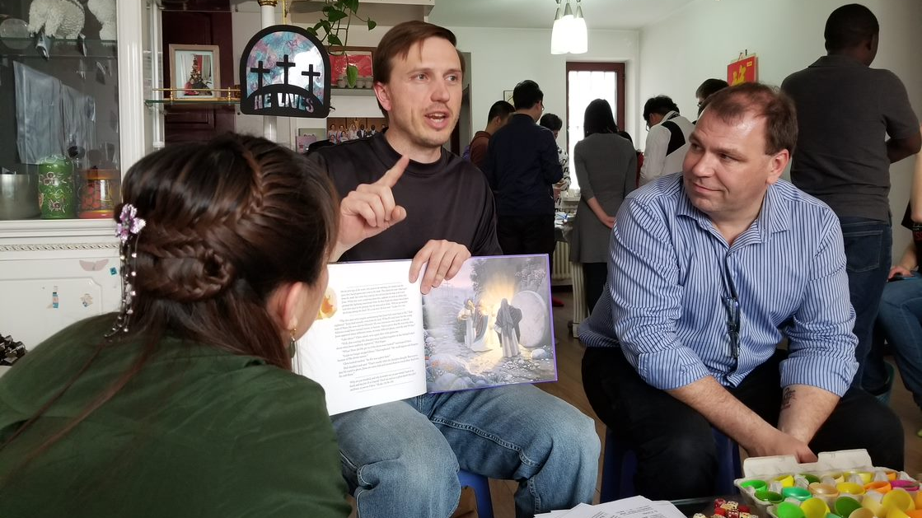
YOU can be an active participant in taking the Gospel “To the Ends of the Earth”…
Notes:
Through the new WELS program for short-term mission trips… (see next slide)
Pictured: St. Martin’s, Watertown, SD sent a team to East Asia to host an Easter outreach event
March 29-April 6 (8 days) – Shared the Easter story with 51 people who had never heard it before

Slide 24

Notes:
Overview:
WELS Mission Journeys, the official WELS program for short-term mission trips, provides an opportunity for all WELS members to walk together in the Great Commission. Through church- or school-based volunteer trips to WELS mission fields at home and abroad, members have the opportunity to engage in Christian service. Pre-trip training led by a Mission Journeys team leader equips volunteers to have significant impact during their trip. While volunteering, the learning and sharing of outreach ideas will allow teams to explore how they can use their God-given abilities to lead an outreach event upon their return home. With the Lord’s blessing, these trips will inspire a lifelong journey of service and outreach for all who volunteer.
WELS Mission Journeys Coordinator: Mr. Shannon Boehme (previously with Friends of China for 17 years)
Three Unique Program Steps:
Pre-trip training: Through pre-trip training, you will develop a spiritual plan for your earthly mission journey. Teams receive training materials that provide opportunities for spiritual growth, team building, and enhanced cultural understanding.
During Trip: Your Mission Journey will provide you with a new perspective on the urgency of sharing the Gospel. With everything centered on our Savior, you will develop meaningful relationships with your team, host congregations, and even members of the community you witness to.
Post-Trip Outreach Event: Your team will have the opportunity to lead an outreach activity or event in your community through your local congregation. This will allow your team to take what you’ve learned and apply it back home, continuing to walk together in the Great Commission.
More Program Details:
Open to all WELS members age 13 and up – you don’t need any specific experience to go on a trip (Example – St. Matthew’s trip to Quito, Ecuador; one person on the team knew a little Spanish)
Goal is to offer 40 one- to two-week trips in the first year, with 200 trips completed after 3 years
75% of trips will be domestic, 25% international

Slide 25
All to God’s Glory!
“Now to Him who is able to do immeasurably more than all we ask or imagine, according to His power that is at work within us, to Him be glory in the church and in Christ Jesus throughout all generations for ever and ever! Amen.”
Ephesians 3:20,21

Slide 26


