Slide 1
LESSON TWO

Slide 2
We tend to think of love as a mystery, and the mystery of what makes us fall in love is fascinating… but staying in love is not mysterious. What makes marriage work is predictable, universal and completely under our control. People stay in love in very common ways.

Slide 3
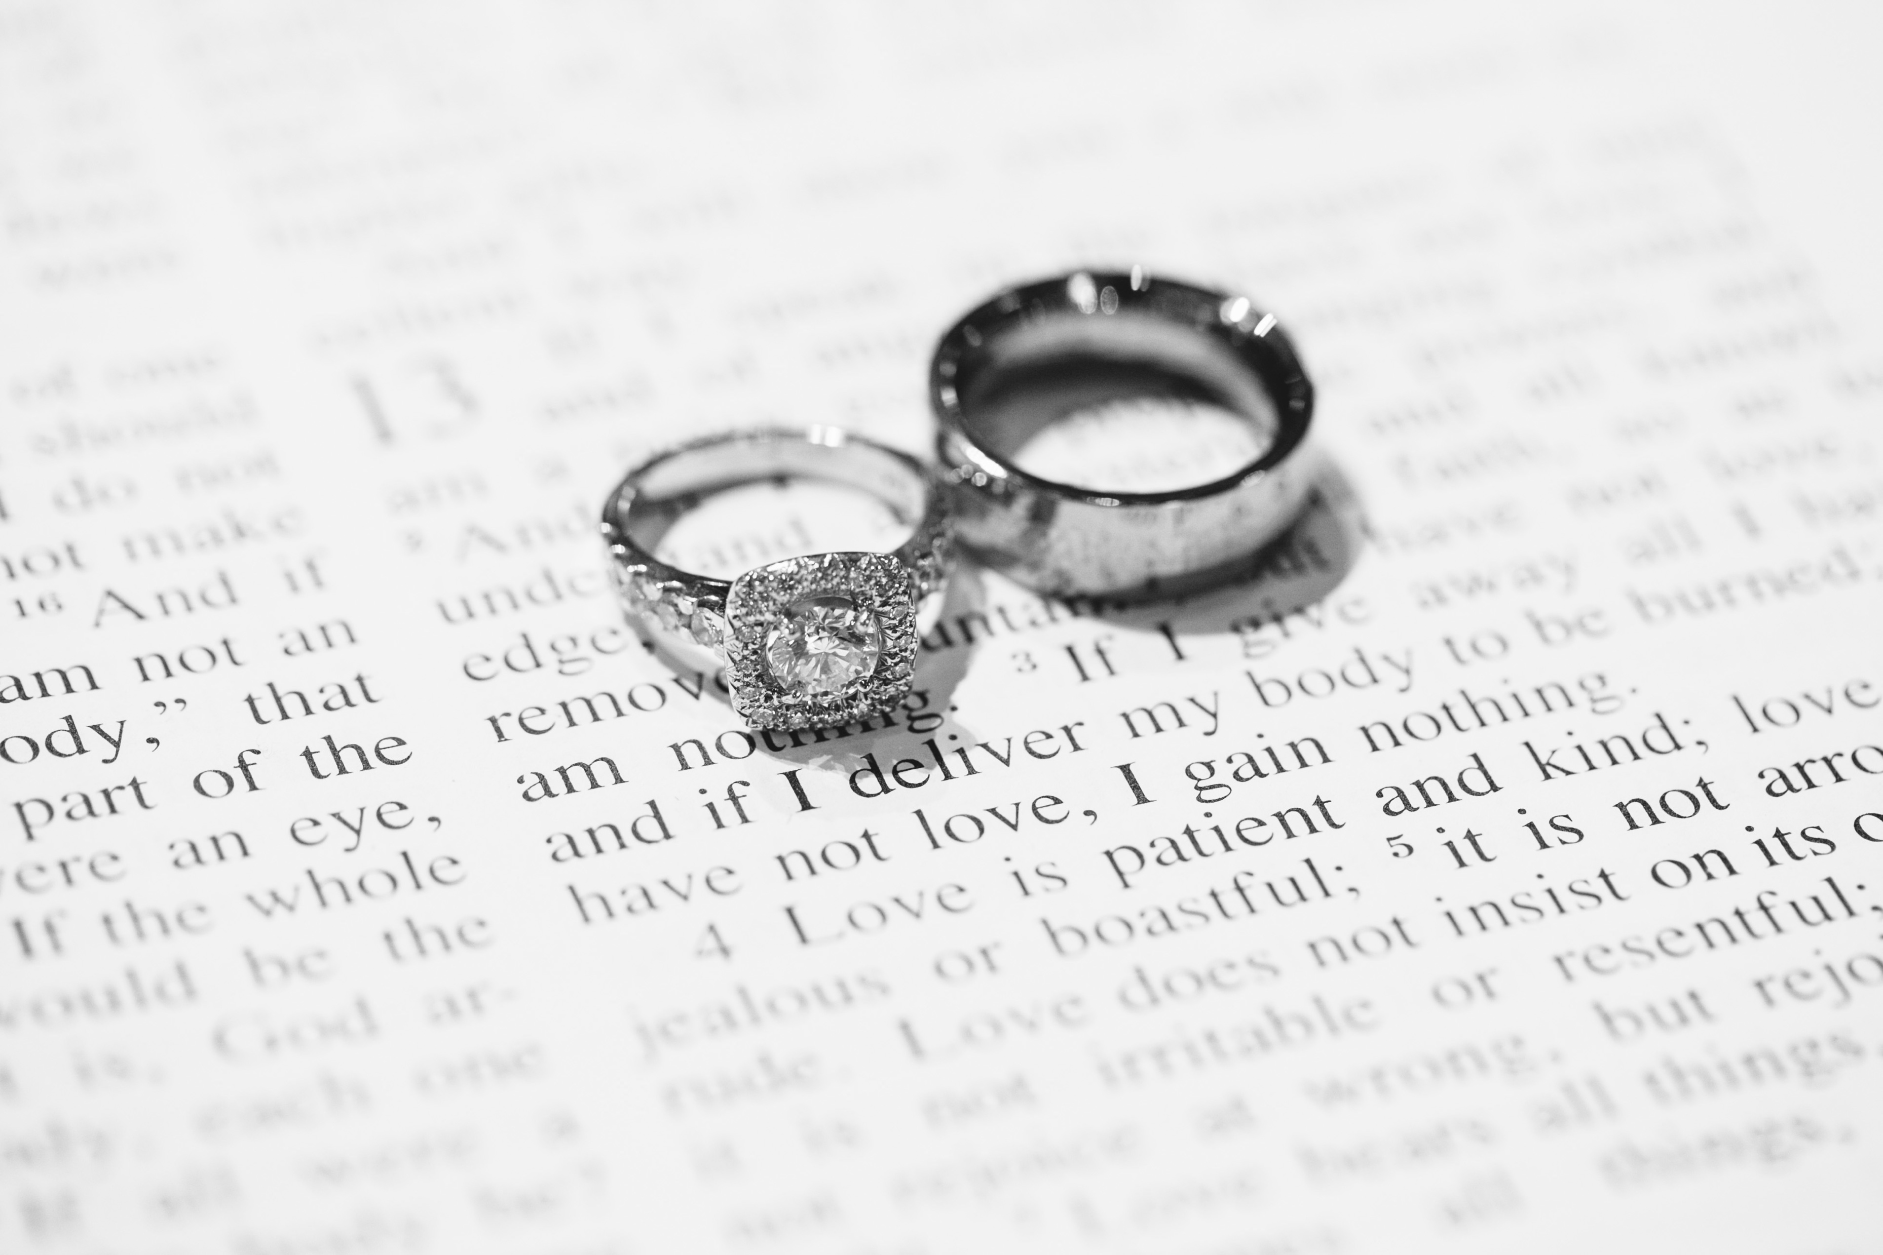
“Love is patient, love is kind. It does not envy, it does not boast, it is not proud. It does not dishonor others, it is not self-seeking, it is not easily angered, it keeps no record of wrongs. Love does not delight in evil but rejoices with the truth.” (1 Corinthians 13:4-6)

Slide 4
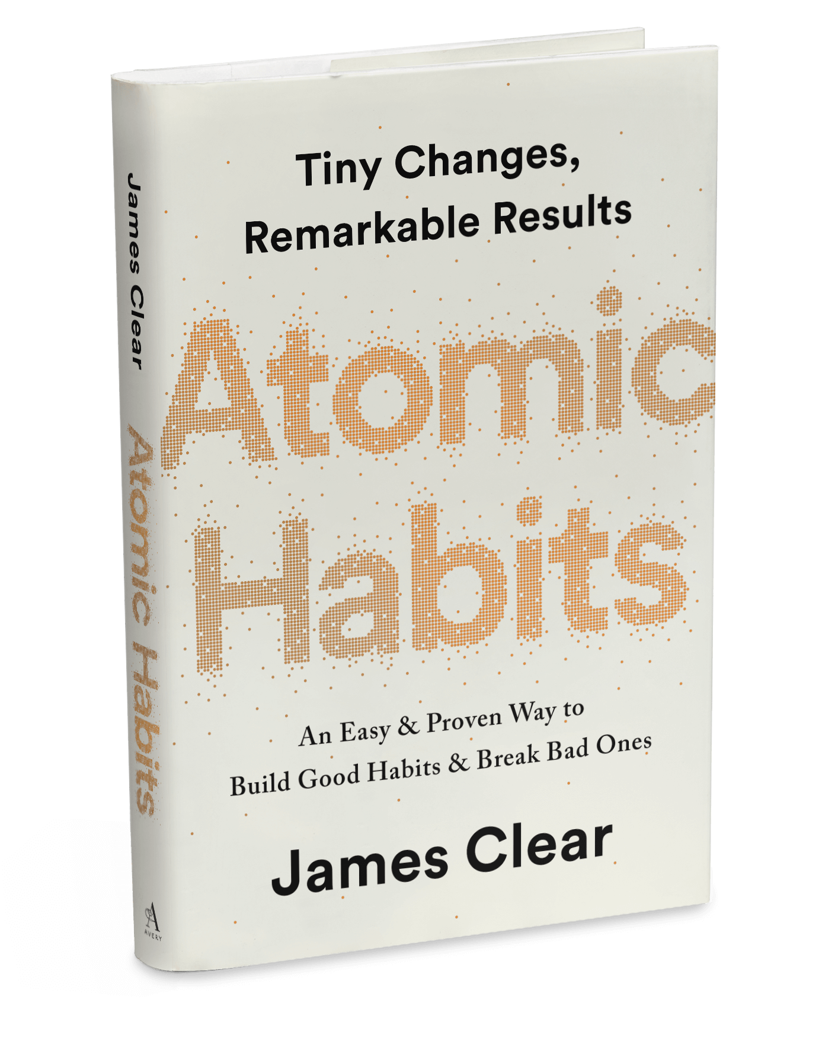
The impact of steady errors…
When we repeat 1 percent errors, day after day, by replicating poor decisions, duplicating tiny mistakes, and rationalizing little excuses, our small choices compound into toxic results. It’s the accumulation of many missteps—a 1 percent decline here and there—that eventually leads to a problem.

Slide 5
The impact of positive changes…
Similarly, a slight change in your daily habits can guide your life to a very different destination.

