Slide 1
LESSON ONE

Slide 2
What might some of those
happy places be?

Slide 3
“…marriage is everywhere commended in Scripture to be among the choicest of God’s blessings to mankind.”
A Marriage Rite

Slide 4
“The happy state of matrimony is the surest and most lasting foundation of comfort and love.”
Benjamin Franklin

Slide 5
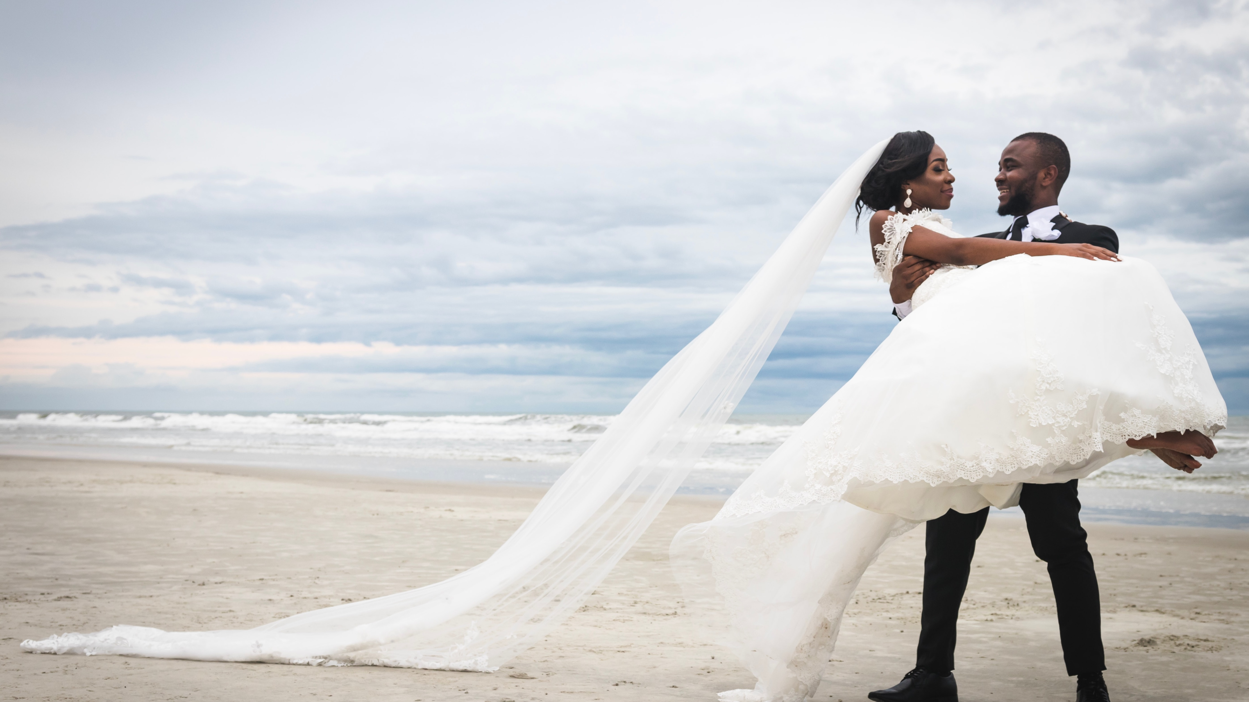
“The highest happiness on earth is the happiness of marriage.”
William Lyon Phelps

Slide 6
“When you’re with me, baby, the skies will be blue for all my life…so happy together.”
The Turtles

Slide 7
Understanding the
Obstacles
Curse of FAMILIARITY
Epidemic of EXHAUSTION
Chapters of CHANGE
Fruits of the FLESH

Slide 8
Romans 7:18
For I know that good itself does not dwell in me, that is, in my sinful nature. For I have the desire to do what is good, but I cannot carry it out.

Slide 9
Mark 7:21,22
For it is from within, out of a person’s heart, that evil thoughts come—sexual immorality, theft, murder, adultery, greed, malice, deceit, lewdness, envy, slander, arrogance and folly.

Slide 10
Embracing the Solution
Christ Jesus is the Solution

Slide 11
Jesus Is the Key
to Overcoming Obstacles

