Slide 1
LESSON THREE

Slide 2
I AM DEARLY LOVED by GOD.

Slide 3
I AM DEARLY LOVED by GOD.
I AM a
CHILD of GOD.

Slide 4
I AM DEARLY LOVED by GOD.
I AM a SINNER but FORGIVEN.
I AM a
CHILD of GOD.

Slide 5
I HAVE GOOD/BAD DAYS, but I ALWAYS WEAR the RIGHTEOUSNESS of CHRIST in MY BAPTISM.
I AM DEARLY LOVED by GOD.
I AM a SINNER but FORGIVEN.
I AM a
CHILD of GOD.

Slide 6
I HAVE GOOD/BAD DAYS, but I ALWAYS WEAR the RIGHTEOUSNESS of CHRIST in MY BAPTISM.
I AM DEARLY LOVED by GOD.
I AM a SINNER but FORGIVEN.
I AM a
CHILD of GOD.
I AM an HEIR.

Slide 7
Committed to
COMMUNICATE

Slide 8
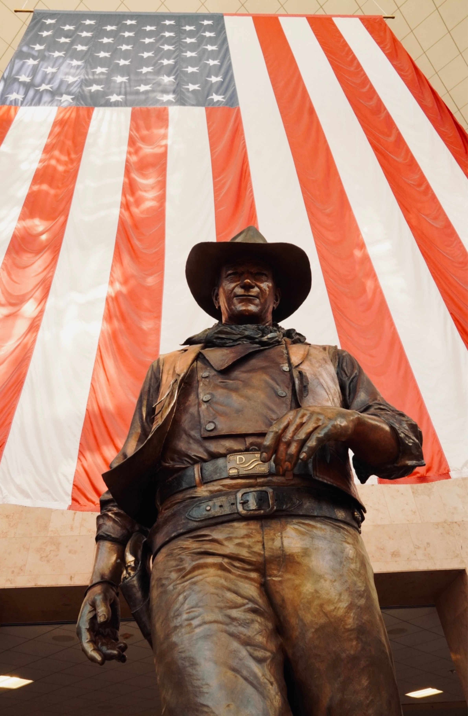
John says…
“Real men don’t apologize.”
True Grit
“Never apologize; it’s a sign of weakness.”
She Wore a Yellow Ribbon

Slide 9
John says…
“If we claim to be without sin, we deceive ourselves and the truth is not in us. If we confess our sins, he is faithful and just and will forgive us our sins and purify us from all unrighteousness.”
The Bible (1 John 1:8-9)

Slide 10
Words BUILD UP or TEAR DOWN.

Slide 11
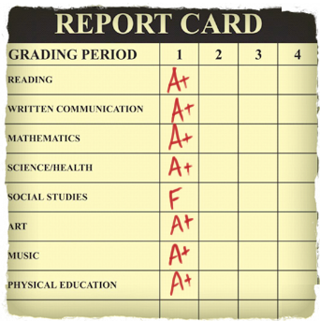
The Impact of Negativity
COMPLIMENT
COMPLIMENT
COMPLIMENT
COMPLIMENT
CRITICISM
COMPLIMENT
COMPLIMENT
COMPLIMENT

Slide 12
Words INFORM/EDUCATE.

Slide 13
Give reasons why this statement is false.
"After being married for 19 years, I know exactly what my spouse needs and wants.”

Slide 14
Words are only PART of our communication.

Slide 15
My greater goal is to better
UNDERSTAND my spouse
rather than to be UNDERSTOOD.

Slide 16
I can improve my communication
by becoming a better LISTENER.

Slide 17
Committed to be
CONSIDERATE

Slide 18
Committed to be
CHRIST-LIKE

Slide 19
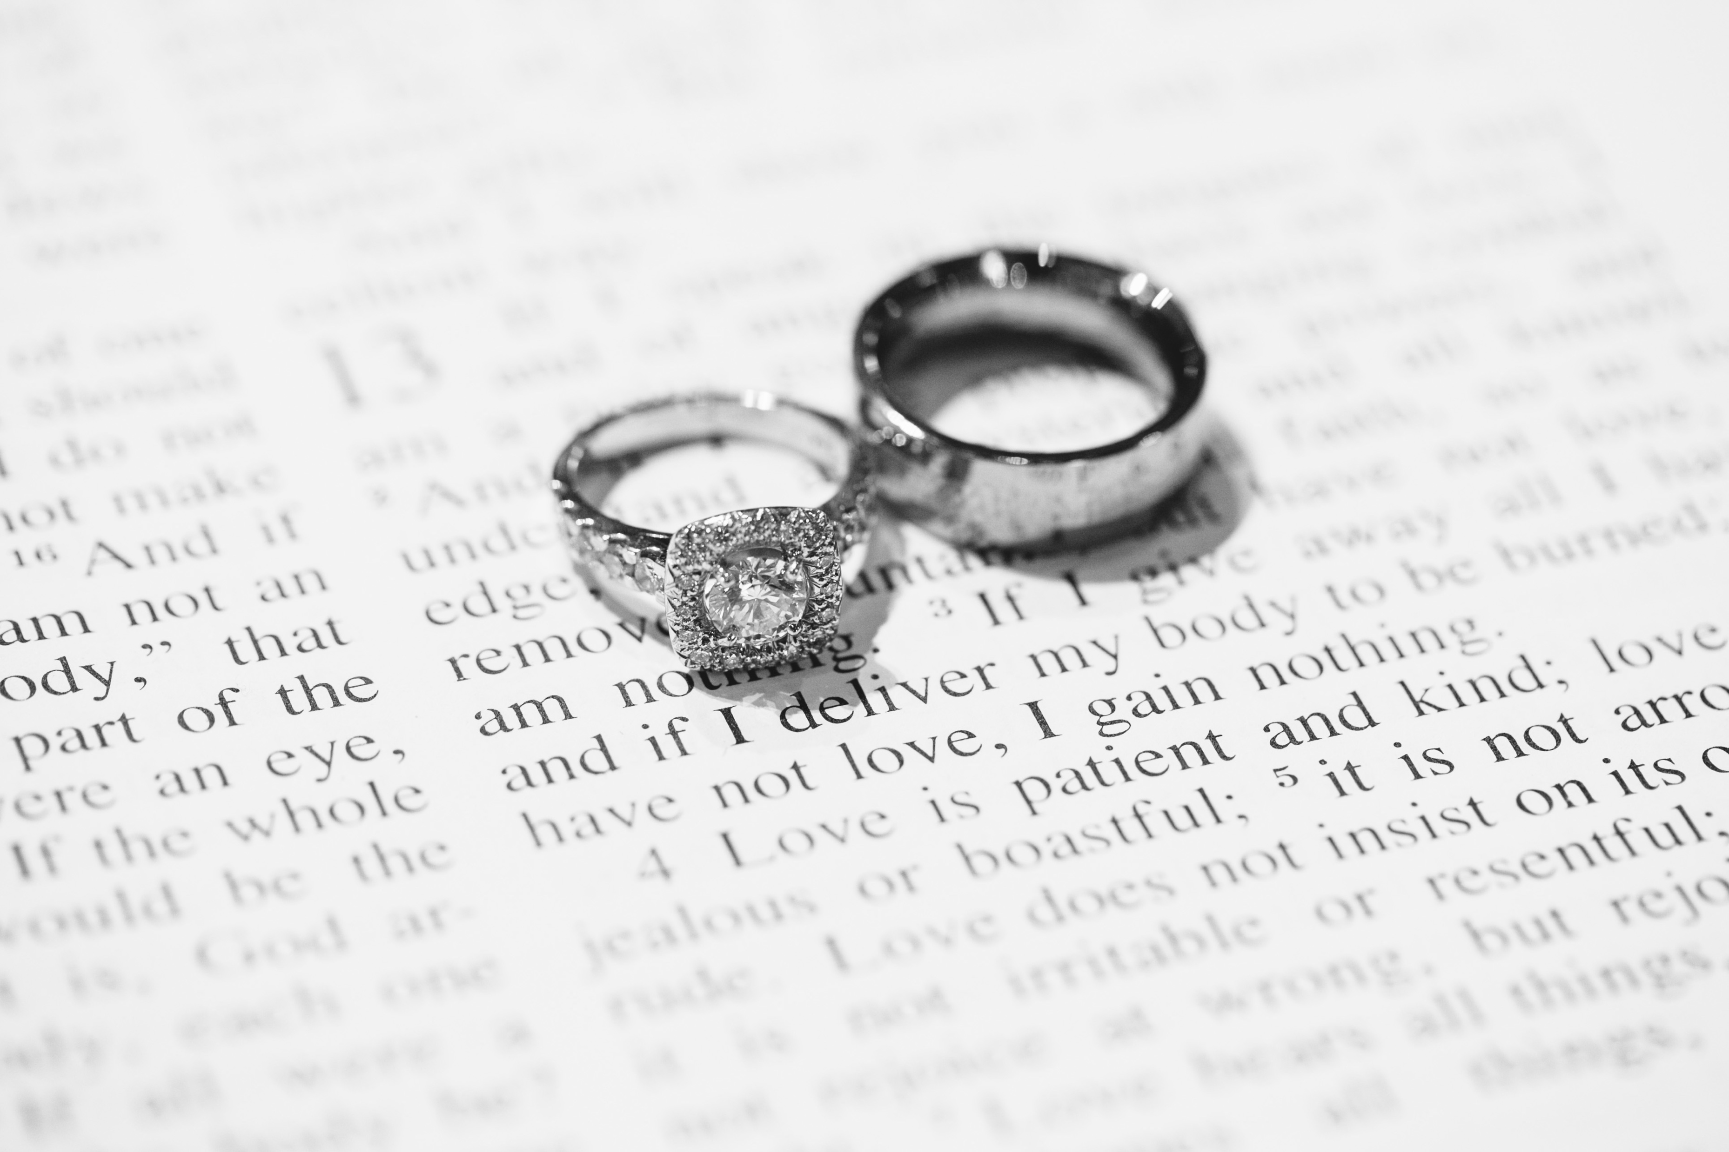

Slide 20
When I speak and act more like Christ, I am
Honoring Christ
Honoring Spouse
Touching Heart

