Slide 1
The Mission of the Church
producing a congregational mission statement

Slide 2
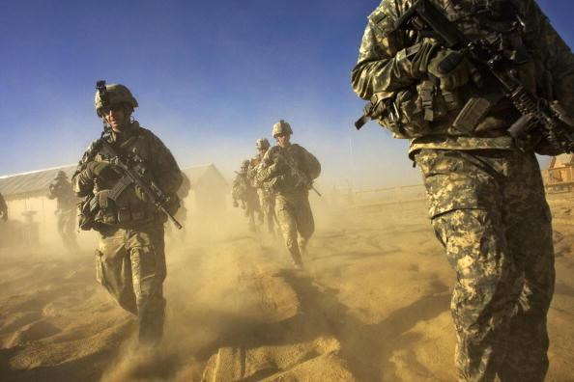
Task | Job | Mission
A collection of tasks that are done routinely
An important task or job that is allotted or assigned
A piece of work

Slide 3
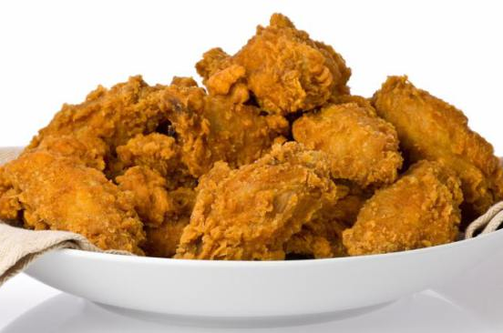
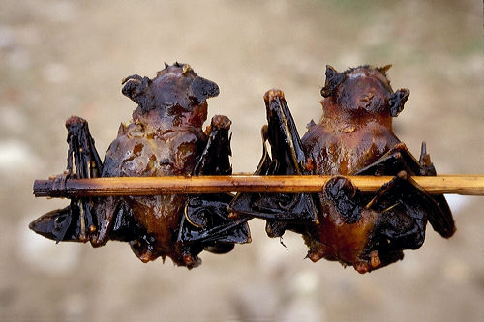
Raison d’etre “the reason to be”

Slide 4
Part 1 The Concept of “Mission” in Scripture
A mission is given from above.
It is never self-appointed.
A mission statement focuses on the heart of the matter.
It does not focus on the tasks and jobs that might help carry out that mission.

Slide 5
Part 2 The Mission Christ Has Given to the Church
The “Great Commission” passages:
Matthew 28:18-20
Mark 16:15-16
Luke 24:46-48
Acts 1:8
We pay especially attention to these because:
They were given to all Jesus’ disciples, not just individuals.
They were spoken by Jesus very shortly before he ascended.

Slide 6
The Great Commission
Scripture passage | What is the mission? | Who is the target of this mission? | How is this mission carried out? | Where is this mission carried out?
Matthew 28:18-20
Mark 16:15
Luke 24:46-48
Acts 1:8
all nations
baptizing and teaching
Go. Make disciples.
in all nations
Go. Preach the good news.
gospel and baptism
all creation
all the world
preaching repentance and forgiveness
Be witnesses.
beginning at Jerusalem
all nations
people in Jerusalem, Judea, Samaria, and the earth
Jerusalem, Judea, Samaria, and the ends of the earth
Be my witnesses.
with power

Slide 7
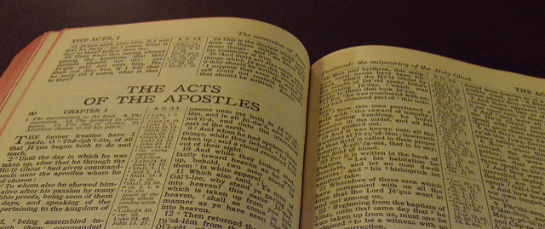
Part 3 Christ’s Mission Carried Out in the Early Church

Slide 8
“committed”
We are committed to the mission of the Church because we were reconciled to God and are eternally grateful.
We are committed to the mission of the Church because Christ honors us greatly by asking us to be his ambassadors.
We are committed to the mission of the Church because Christ died to redeem all people, and so we want all to receive the benefits of his work.

Slide 9
Further Discussion
producing a congregational mission statement

