Slide 1
Compassion Ministry
Cultivating a Caring Congregation

Slide 2
WELS Special Ministries

Slide 3
It’s not one thing
Satan wages war on the church on many fronts.
Noah and Elijah remained faithful in eras when many turned away from God.

Slide 4
It’s not one thing
Satan wages war on the church on many fronts.
False teachers have been wolves among the flock as Jesus said they would, yet the apostles stood firm.

Slide 5
It’s not one thing
Satan wages war on the church on many fronts.
We know that failure to evangelize, lack of time spent in God’s Word, and problems with worship have a harmful effect on the life and health of God’s people.

Slide 6
It’s not one thing
Jesus foretold another devastating force that would disrupt the church in the end times: “Because of the increase of wickedness, the love of most will grow cold.” (Matthew 24:12)
Listen to what some critics of the church and those who have left congregations are saying.

Slide 7
“At church, I could tell someone was standing near me, but no one ever spoke to me. I felt so alone.” (a blind church member)
“We were asked not to come back to the church.” (a parent of a child with autism who disrupted worship)
“We wanted our child to receive confirmation instruction. The pastor said that he didn’t have time for a special education class for ‘one person.’” (a parent of a child with developmental disabilities)

Slide 8
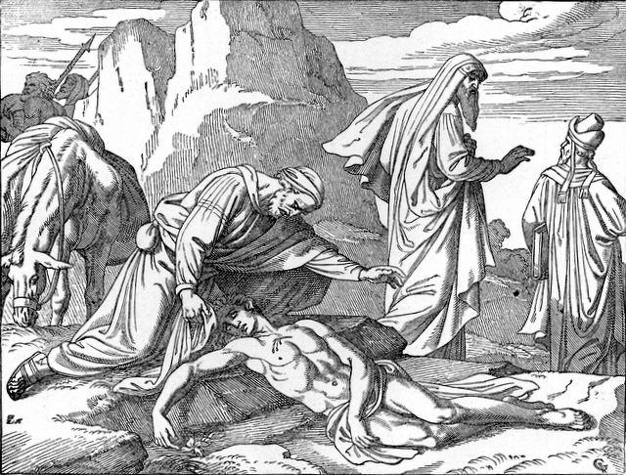
The perception of Christian congregations today:
“They” don’t care about people’s problems.
(The priest and the Levite, rather than the Good Samaritan)

Slide 9
Christ’s love in action
Let’s review
why compassion ministry
happens among Christians.

Slide 10
Compassion Ministry
“Dear friends, let us love one another, for love comes from God. Everyone who loves has been born of God and knows God. Whoever does not love does not know God, because God is love. . . We love because he first loved us.” (1 John 4:7-8,19)
“Therefore, I tell you, her many sins have been forgiven—as her great love has shown. But whoever has been forgiven little loves little.” (Luke 7:47)
God’s agape love gives birth to love among us.

Slide 11
Compassion Ministry
“We know that we have passed from death to life, because we love each other. Anyone who does not love remains in death.” (1 John 3:14)
“This is how we know who the children of God are and who the children of the devil are: Anyone who does not do what is right is not God’s child, nor is anyone who does not love their brother and sister.” (1 John 3:10)
“By this everyone will know that you are my disciples, if you love one another.” (John 13:35)
God’s agape love among us testifies to our new birth.

Slide 12
Compassion Ministry
“And he has given us this command: Anyone who loves God must also love their brother and sister.” (1 John 4:21)
“A new command I give you: Love one another. As I have loved you, so you must love one another.” (John 13:34)
“The commandments . . . are summed up in this one command: ‘Love your neighbor as yourself.’” (Romans 13:9)
God’s agape love among us is a command.

Slide 13
Compassion Ministry
“But the fruit of the Spirit is love, joy, peace, forbearance, kindness, goodness, faithfulness.” (Galatians 5:22)
“And hope does not put us to shame, because God’s love has been poured out into our hearts through the Holy Spirit, who has been given to us…” (Romans 5:5)
God’s agape love among us is the fruit of the Spirit’s work.

Slide 14
Compassion Ministry
“If I speak in the tongues of men or of angels, but do not have love, I am only a resounding gong or a clanging cymbal. If I have the gift of prophecy and can fathom all mysteries and all knowledge, and if I have a faith that can move mountains, but do not have love, I am nothing. If I give all I possess to the poor and give over my body to hardship that I may boast, but do not have love, I gain nothing.” (1 Corinthians 13:1-3)
God’s agape love among us is essential to Christian life.

Slide 15
We put flesh on agape by what we do and say
“Suppose a brother or a sister is without clothes and daily food. If one of you says to them, ‘Go in peace; keep warm and well fed,’ but does nothing about their physical needs, what good is it?” (James 2:15-16)
Our actions reveal agape.

Slide 16
We put flesh on agape by what we do and say
“This is how we know what love is: Jesus Christ laid down his life for us. And we ought to lay down our lives for our brothers and sisters. If anyone has material possessions and sees a brother or sister in need but has no pity on them, how can the love of God be in that person? Dear children, let us not love with words or speech but with actions and in truth.” (1 John 3:16-18)
Our actions reveal agape.

Slide 17
We put flesh on agape by what we do and say
“And let us consider how we may spur one another on toward love and good deeds, not giving up meeting together, as some are in the habit of doing, but encouraging one another—and all the more as you see the Day approaching.” (Hebrews 10:24-25)
Our words reveal agape.

Slide 18
Where does a church put this into practice?

Slide 19
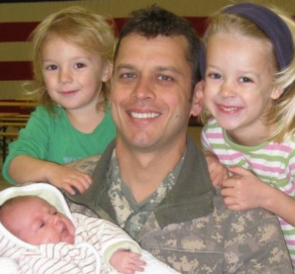
Teach Christians to see their individual callings and to live them.
For example, not everyone has a spouse deployed in the military – how should members of the church family see their role toward this “single parent” among them?
Vocation

Slide 20
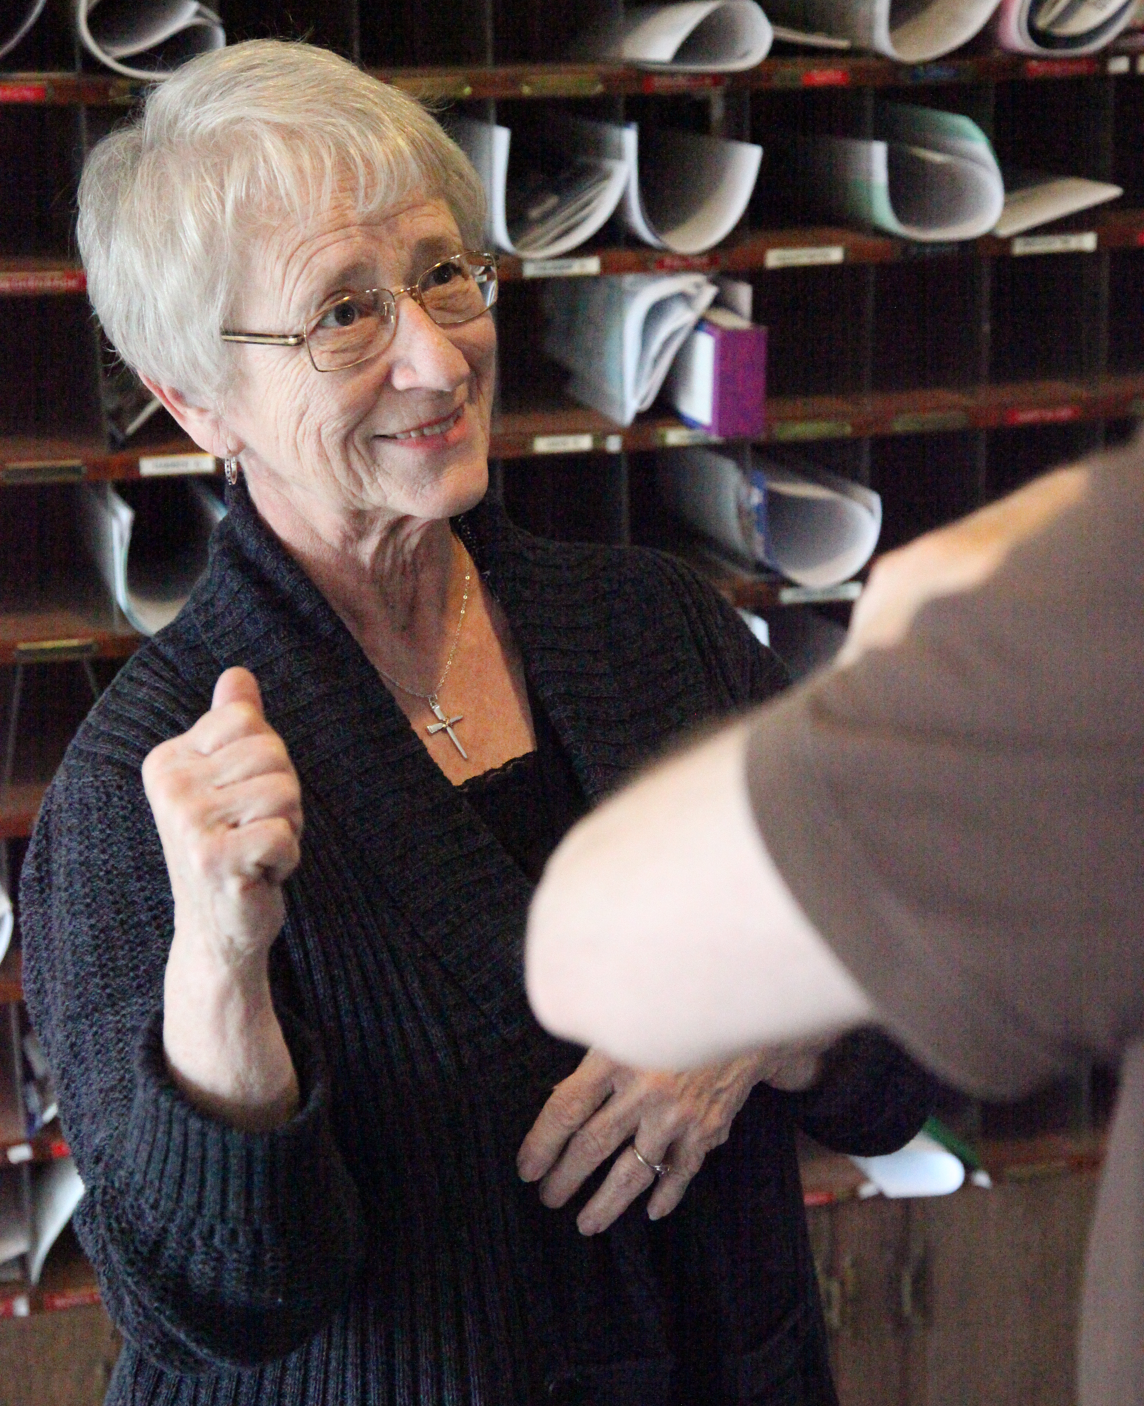
Vocation
Teach Christians to see their individual callings and to live them.
A member of your congregation is deaf and uses sign language. How might members carry out their vocation toward this member and the member’s family?

Slide 21
Vocation
Teach Christians to see their calling as a neighbor and to live it.
Your neighbor’s son has been sent to jail. How might you be called to serve as a neighbor in this situation?

Slide 22
Inclusion
Demonstrate that people with barriers to gospel ministry belong to the body of Christ.
Instead of focusing on what a person cannot do, seek to discover the roles for which the Lord has equipped a member who is deaf, blind, or developmentally disabled.

Slide 23
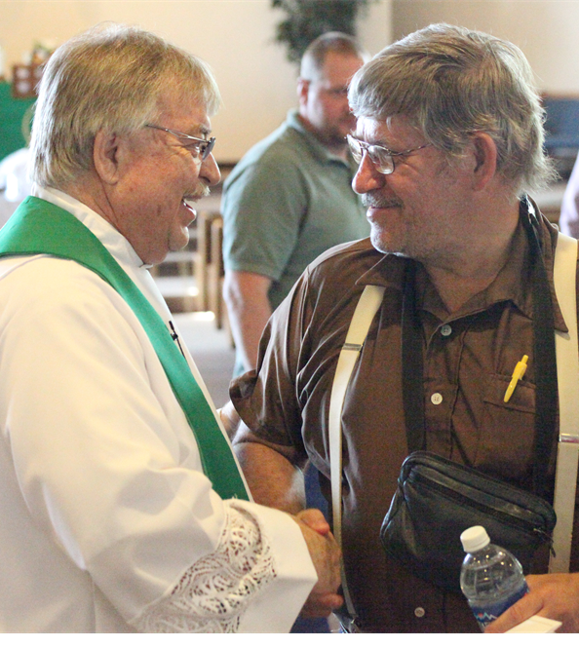
Inclusion
Demonstrate that people with barriers to gospel ministry belong to the body of Christ.
Your outreach committee meeting may require people to speak into a microphone, so that your very hard of hearing but evangelism-minded member can participate.

Slide 24
Outreach
If your church offers compassion ministry, it may improve your outreach.
For some Christians, it is easier to reach out to neighbors with special needs if your church already offers special ministries.

Slide 25
Outreach
If your church offers compassion ministry, it may improve your outreach.
At one time the only WELS plan for outreach was a Lutheran elementary school. Compassion ministry can be an organized, intentional ministry to the community.

Slide 26
Who is equal to such a task?
Overworked called workers?
Stressed family members who already bear the daily burden?

Slide 27
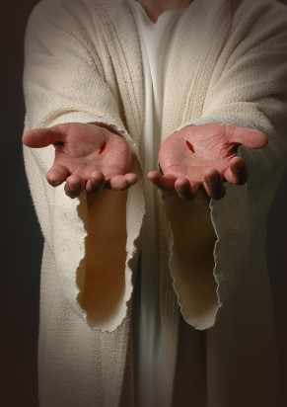
Spiritual realities
1
Christ has all the resources he needs for the work he gives us.

Slide 28
Spiritual realities
2
The Body of Christ has many gifts and abilities given by the Lord for service.

Slide 29
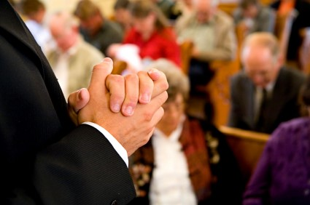
Spiritual realities
3
Jesus invites us to pray for his solution. It might be in the future.

Slide 30
Equipping
WELS Special Ministries
Believing that
the Lord has the resources needed,
the Body of Christ has the gifts and abilities,
the Lord answer prayers,
God’s people prayerfully recruit members for compassionate ministry.

Slide 31
Equipping
WELS Special Ministries
Cultivating a compassionate congregation is the calling of pastors and teachers:
“pastors and teachers, to equip his people for works of service”
(Ephesians 4:11-12)

Slide 32
Equipping
WELS Special Ministries
Equipping the people of God for compassion ministry starts in the pulpit and classroom.
Notes:
Compassion is a way of thinking. It is look at the world through God’s eyes and our vocation. Sermons and devotions equip God’s people for compassion ministry by showing God’s people His will that they love one another and serve each other in love. Teach God’s people that compassion ministry is about vocation, about the body of Christ, about inclusion.

Slide 33
Equipping
WELS Special Ministries
Equipping God’s people for compassion ministry often happens on a schedule.
Notes:
Equipping the saints is a rotating task – church leaders equip different groups at different times, church council members in January, Sunday School teachers in September. So the task of equipping someone for special ministry can be slotted during the year.

Slide 34
Equipping
WELS Special Ministries
Equipping God’s people for compassion ministry need not become a burden.
Notes:
Called workers who equip God’s people to serve others have a resource for training their members: WELS Special Ministries.

Slide 35
WELS Special Ministries
Chaplains
Nurses
Counseling
resources
Notes:
At a glance, WELS Special Ministries looks complicated, with eight different committees addressing special needs brought on by disabilities or special circumstances. Adding to the complexity, Special Ministries partners with many other WELS related organizations that carry out Special Ministries work, such as Institutional Ministries (WLIM), Jesus Cares Ministries, and WLCFS Christian Family Solutions.
As complicated at this may appear, the simple approach is the best: if you or someone you love has a special need, simply contact the Special Ministries office at the WELS Center for Mission and Ministry. If we can’t help you, we’ll direct the right organization or person to get in touch with you.

Slide 36
WELS Special Ministries
Pastor Jim Behringer
Director

