Slide 1
Week One
OPEN HEARTS
Firstfruits Giving

Slide 2
Stewardship =
Management of the TOTALITY of the
TIME +
TALENT +
TREASURE +
TRUTH that God gives me

Slide 3
Stewardship does not just give the Lord honor. It demonstrates that we TRUST him.

Slide 4
The focus of firstfruits giving is not the AMOUNT but the ATTITUDE.

Slide 5
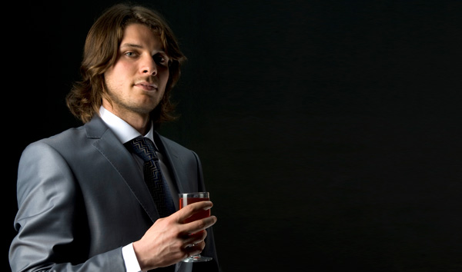
Mark 10:21,22
Jesus looked at him and loved him. “One thing you lack,” he said. “Go, sell everything you have and give to the poor, and you will have treasure in heaven. Then come, follow me.” At this the man's face fell. He went away sad, because he had great wealth.

Slide 6
The focus of firstfruits giving is not on ME but on GOD.

Slide 7
God gave us his FIRST and gave us his BEST.

Slide 8
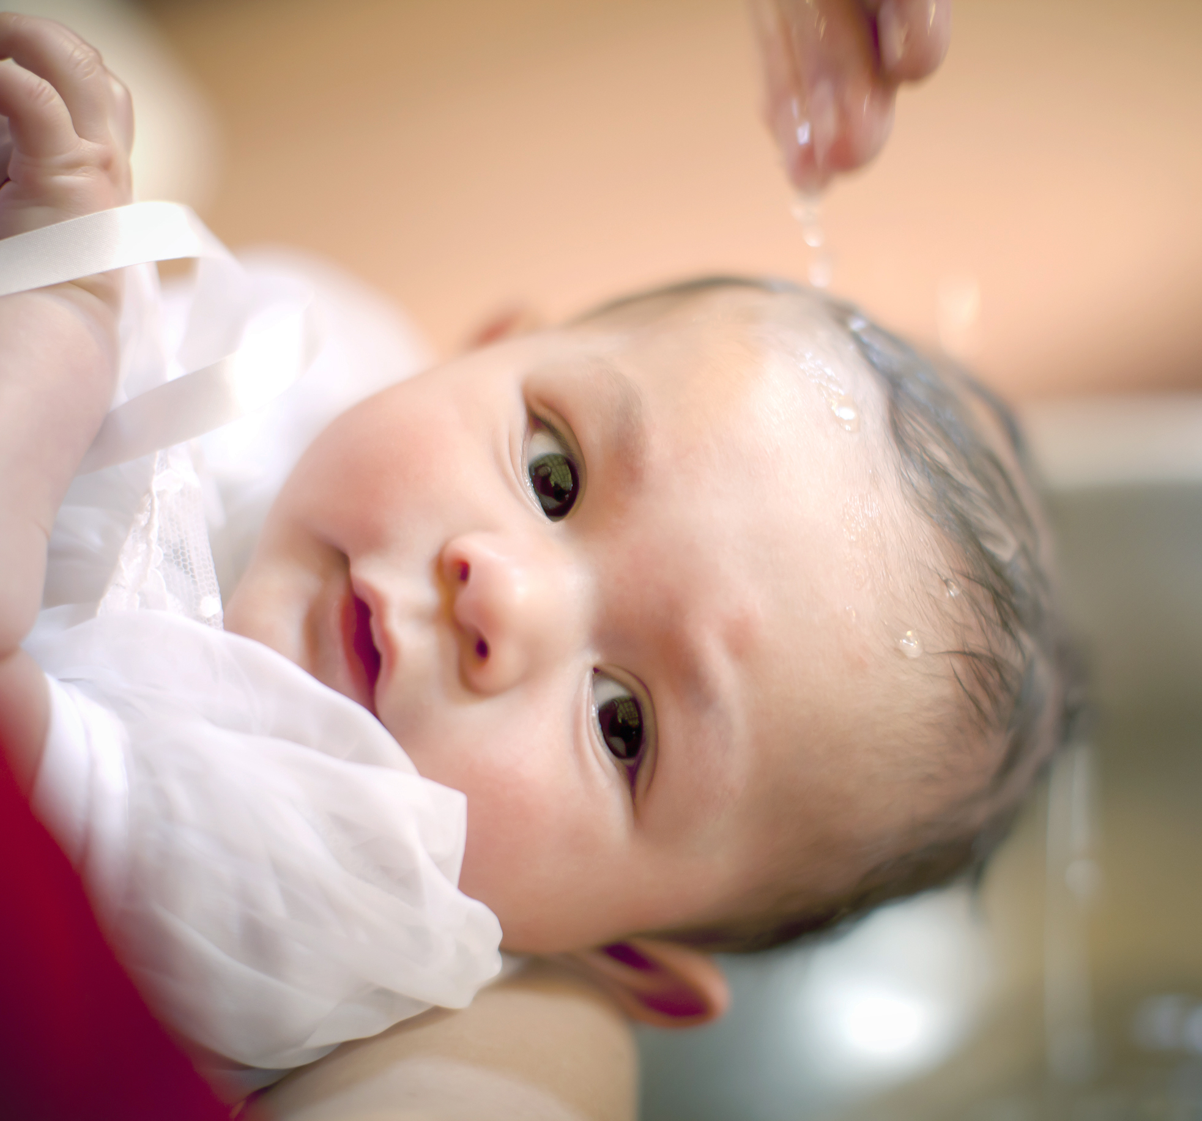
Through my sinful nature, GREED assures that God will always come anywhere but first.
Through the Spirit we are EMPOWERED to give in a way that glorifies God.

