Slide 1
Week Two
OPEN MINDS
Proportionate Giving

Slide 2
97.5% belongs to me
2.5% belongs to God
90% belongs to me
10% belongs to God
nothing belongs to me
100% belongs to God

Slide 3
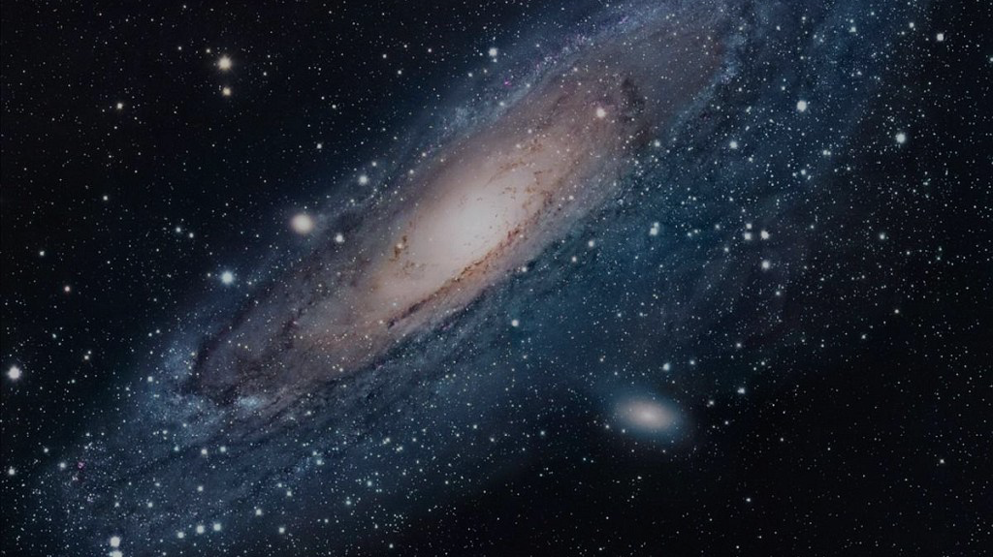
Proportionate giving begins by recognizing who really is the OWNER.

Slide 4
God CREATED everything and therefore OWNS everything.

Slide 5
MINE!

Slide 6
Point / Counter-Point
God says…
Man says…

Slide 7
The Takeaway
If I don’t recognize God’s complete ownership, I need to REPENT of my idolatry.
If I do recognize God’s complete ownership, as his forgiven child I give to him GENEROUSLY.
If my life’s focus is on earthly possessions, every day I live is a day I come closer to losing EVERYTHING.
If my life’s focus is on heavenly treasures, then every day I live is a day I come closer to GAINING everything.

Slide 8
What % should I give?
Abraham gladly gave 10%, a “tithe”
The Old Testament Law COMMANDED people to give multiple tithes.
Zacchaeus freely gave 50%
The widow of Zarephath and the widow at the temple gave 100%

Slide 9
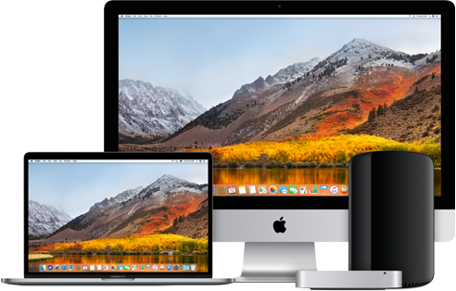
WANTS
NEEDS

Slide 10
Matthew 6:21
Where your treasure is, there your heart will be also.

Slide 11
2 Corinthians 9:8
For you know the grace of our Lord Jesus Christ, that though he was rich, yet for your sakes he became poor, so that you through his poverty might become rich.

