Slide 1
Week Three
OPEN HANDS
Sacrificial Giving

Slide 2
REVIEW
Firstfruits giving: Giving is a key PRIORITY because I love and trust God.
Proportional giving: Stewardship includes prayerfully considering how much of God’s money I need to LIVE ON.

Slide 3
AVERAGE AMERICAN HOUSEHOLD DEBT

Slide 4
Faith grasps God’s promises.
God’s promises give power.

Slide 5
God is neither CRUEL nor a FOOL. If he asks us to do things that are impossible, he then also gives us the ABILITY to do that which he has asked.

Slide 6
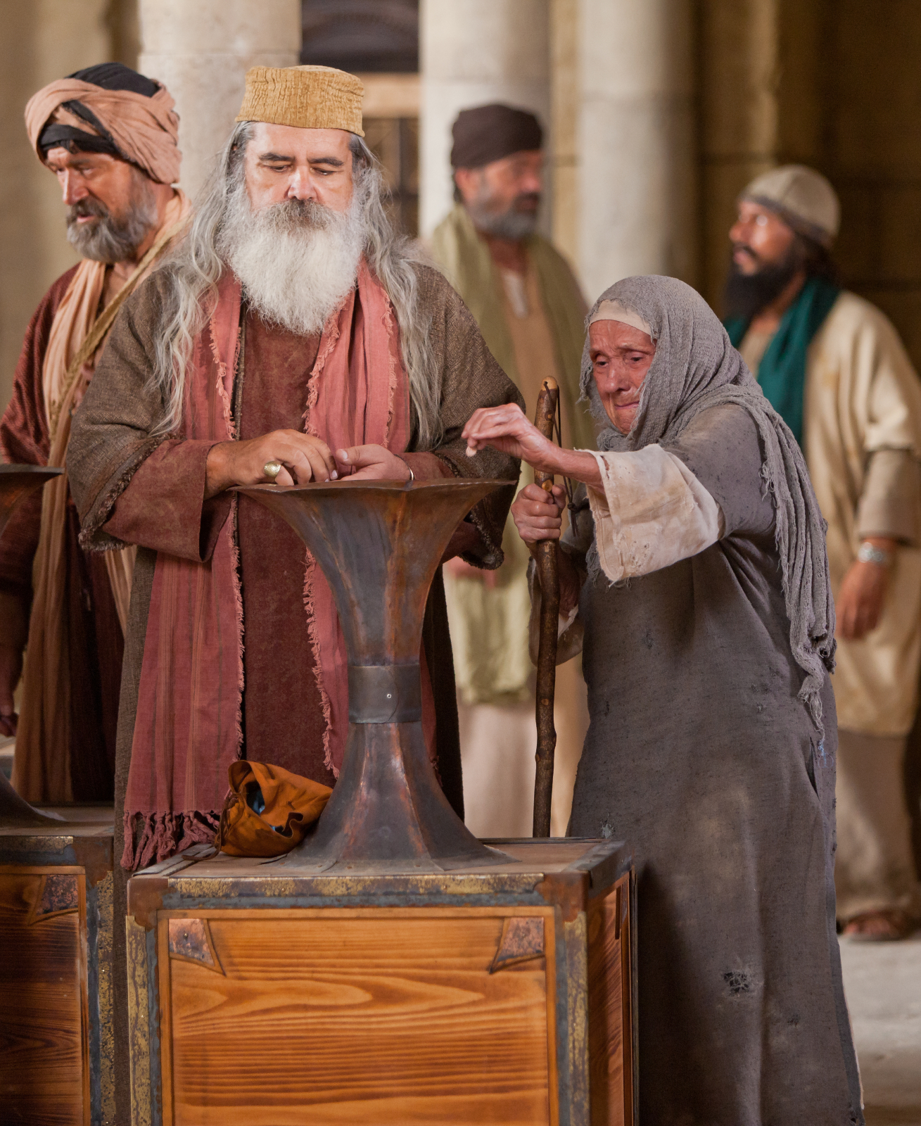
The widow gave 100% of what she had.
In God’s ledger book, a fraction of a PENNY can be more than thousands of dollars.
Jesus is WATCHING what people give.

Slide 7
Giving is not a PASTIME of the rich, but a PRIVILEGE for the poor.
When it comes to giving, the ATTITUDE, not the AMOUNT, is what counts in God’s sight.

Slide 8
PUTTING IT ALL TOGETHER
FIRSTFRUITS giving teaches that giving to God comes first.
PROPORTIONATE giving teaches that we give to God a pre-determined percentage of our wealth.
SACRIFICIAL giving teaches that we may, in joy, give over and above our normal, proportional gifts.

